Slide 1
Build a Watson AI Chatbot from Db2
Sanjula Ganepola, IBM
Software Developer – IBM i App Dev & AI Toolchain
Sanjula.Ganepola@ibm.com

Slide 2
Agenda
Overview of Watsonx Assistant
Planning Your Assistant
Terminology You Should Know
Let’s Build a Chatbot
Integrate with Db2
Next Steps

Slide 3
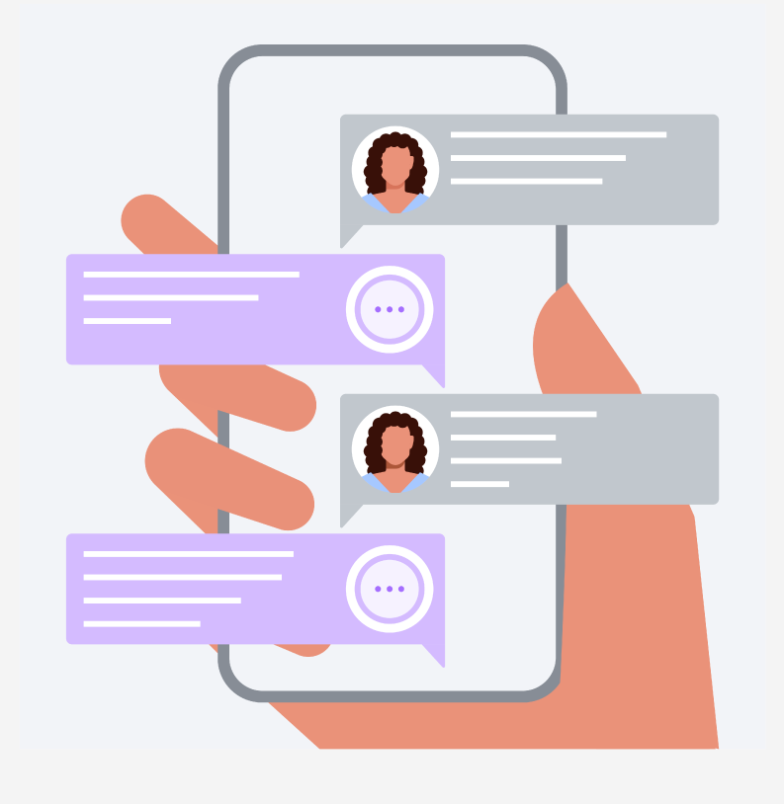
Have you ever built a chatbot?
Choose 1:
Yes, with Watsonx Assistant
Yes, with another tool
No, but we want to
No, we don’t want to
No, never thought about it

Slide 4
Overview of Watsonx Assistant

Slide 5
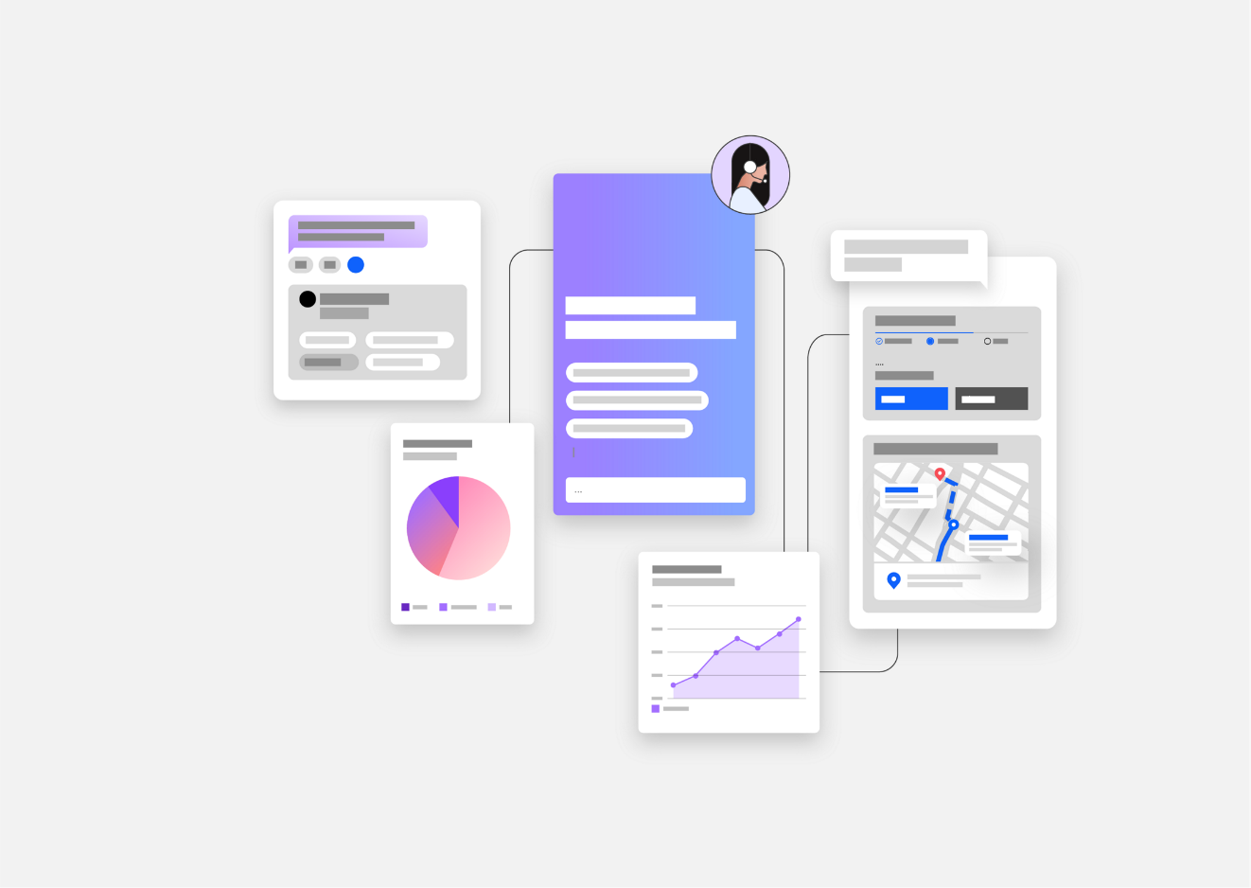
What is Watsonx Assistant?
“Conversational AI solution that empowers anyone to effortlessly build generative AI Assistants that deliver frictionless self-service experiences to customers”
↓
Use Watsonx Assistant to build your own branded live chatbot
💻 Bring the assistant to your customers, where they are
🧠 Create AI-driven conversational flows
📑 Embed existing help content
🤝 Connect to your customer service teams
🎯 Track customer engagement and satisfaction

Slide 6
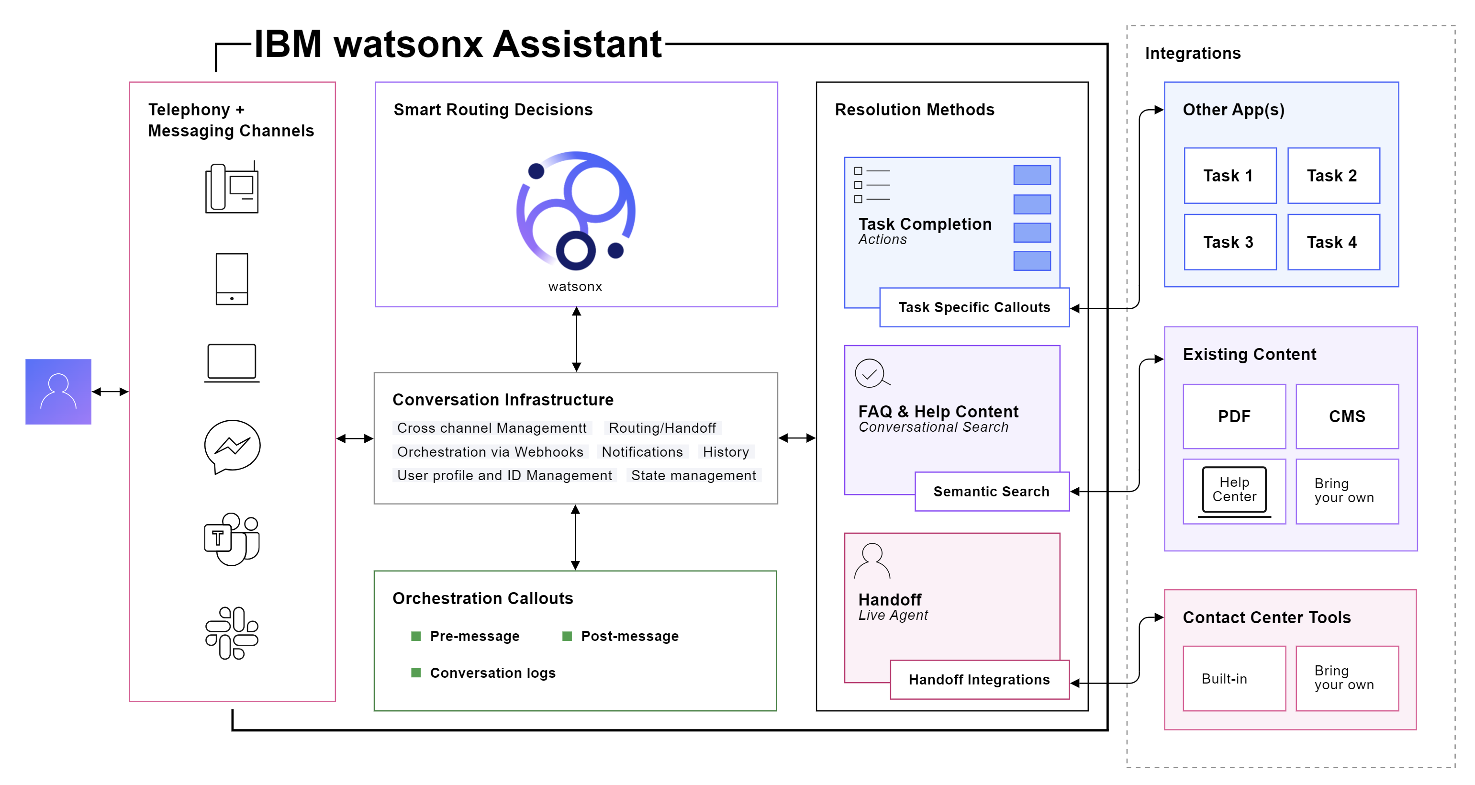
How Does It Work?

Slide 7
Planning Your Assistant

Slide 8
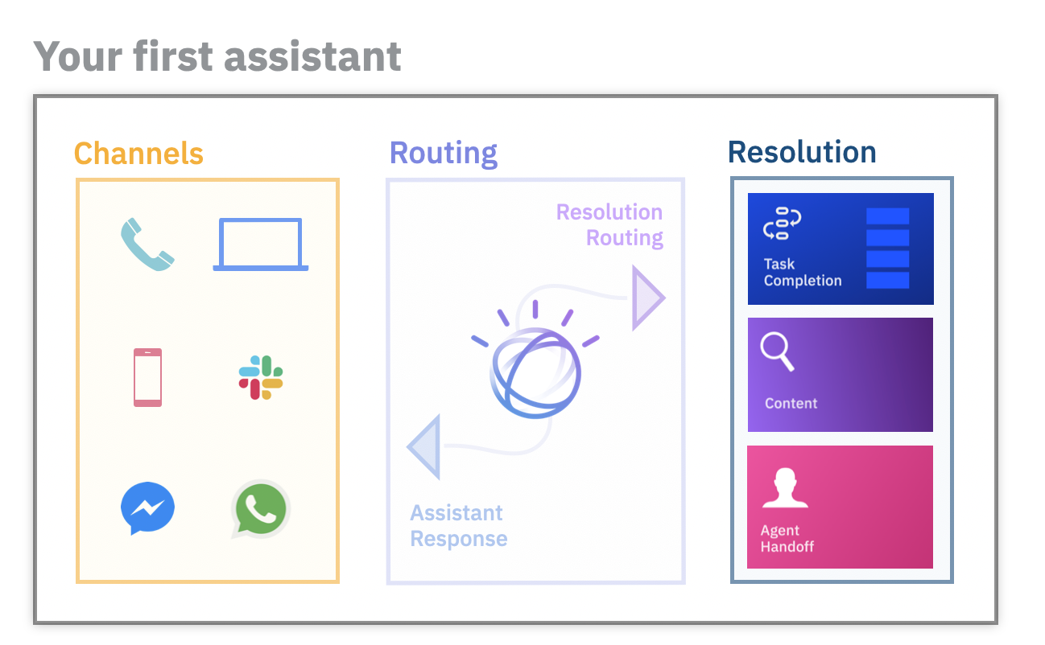
Before building an assistant…
Select an initial channel
Where will customers use your assistant?
Select starting domain
What topic domain can your assistant unify and automate?
Outline frequent topics
What are the most frequent topics which are mostly informational in nature?
Collect content sources
What help content is available to customers today?
Plan handoff strategy
How should customers be routed to human agents?

Slide 9
Terminology You Should Know

Slide 10
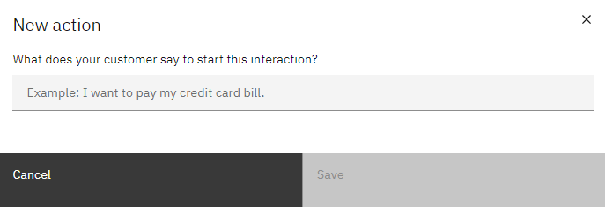
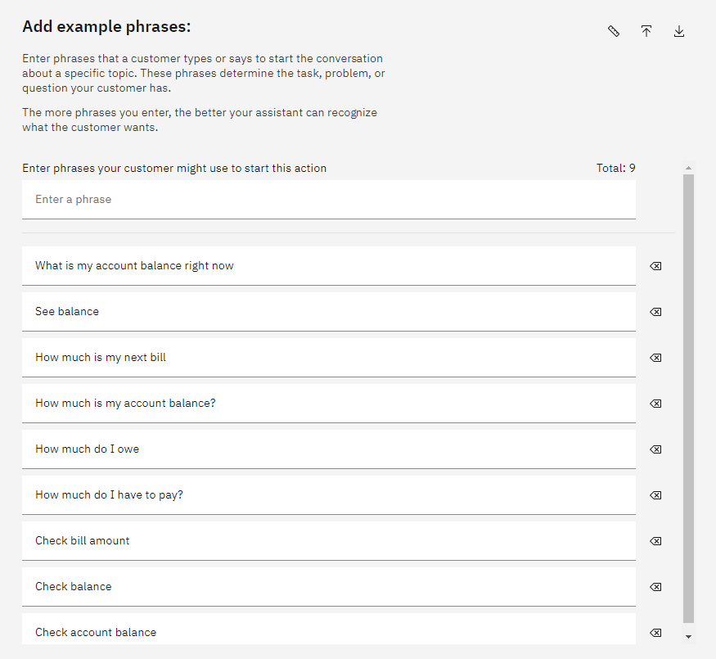
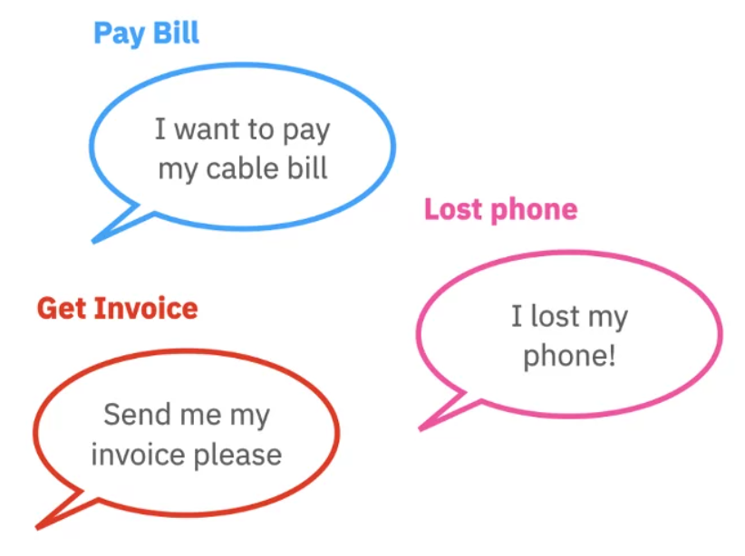
What are Actions and Phrases?
An action is a problem or a task that your customer wants to resolve
Phrases are what customers type or say to start an action
Add multiple phrases to better train your assistant to recognize what customers want

Slide 11
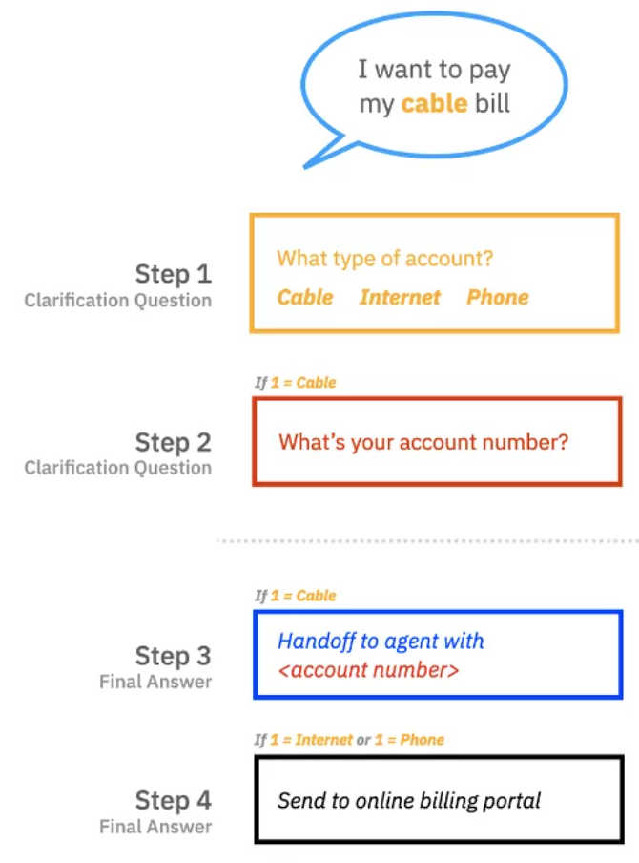
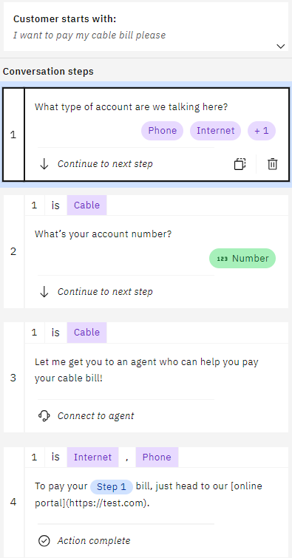
What are Steps and Conditions?
A step is a back-and-forth interaction between your assistant and your customer
Conditions are requirements which must be met for the step to be triggered

Slide 12
Let’s Build a Chatbot

Slide 13




Demo Example – ConnectMe Inc.
ConnectMe Inc. is a telecommunications company with cable, internet, and phone services
ConnectMe Inc.
Goals
Streamline bill payment services
Update account data in real-time
Provide 24/7 support
Customer A
Support Rep A
Database
Customer B
Support Rep B
FAQ Manual

Slide 14
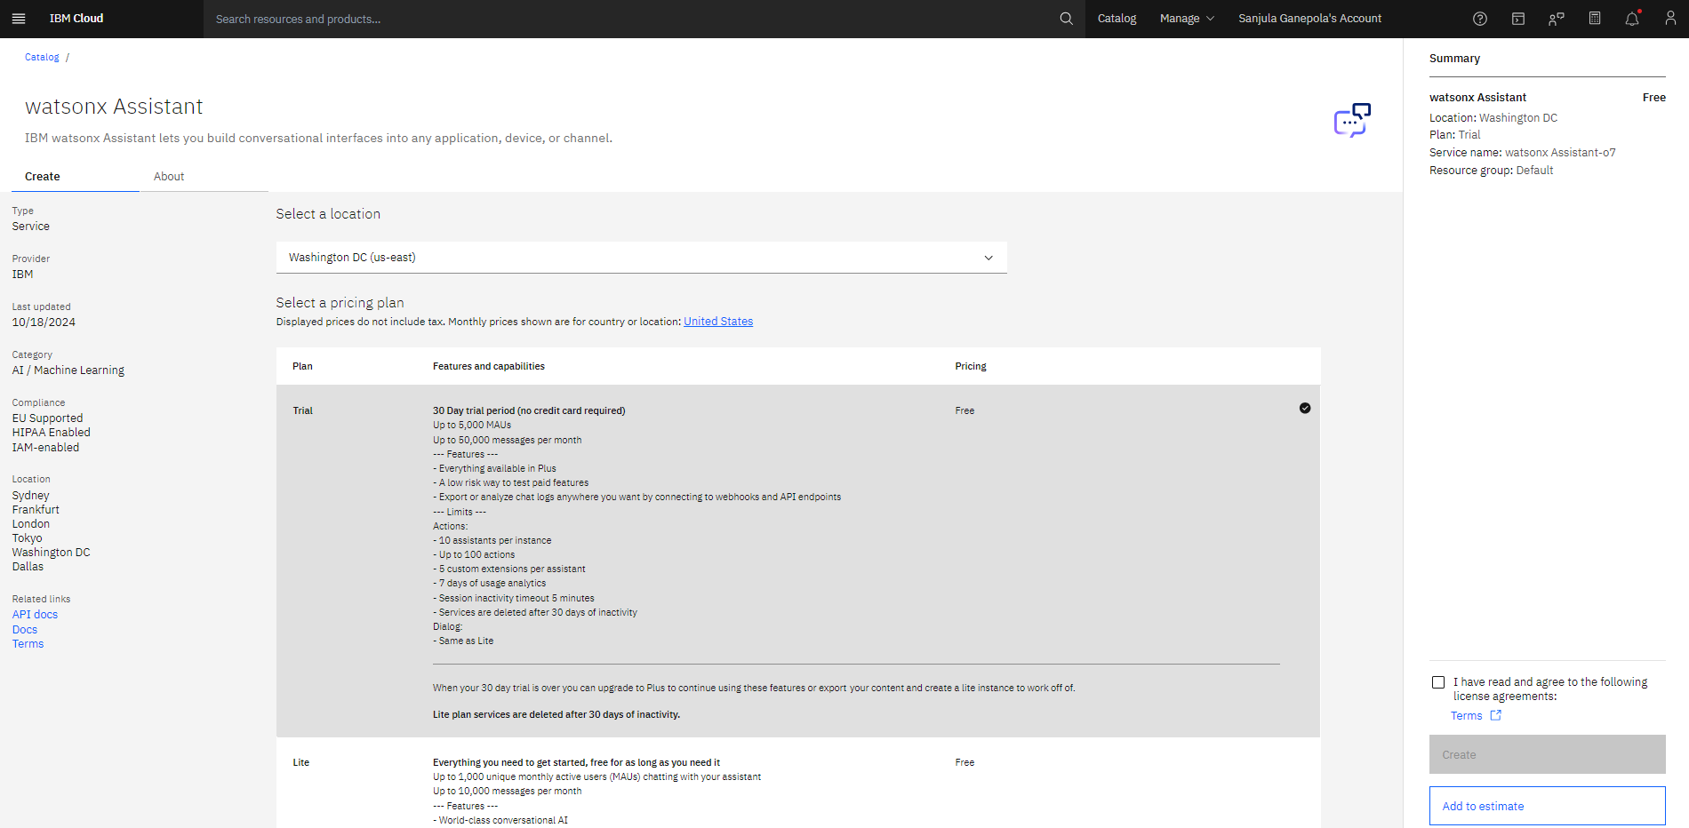
Create Watsonx Assistant Instance
💡30 DAY TRIAL!

Slide 15
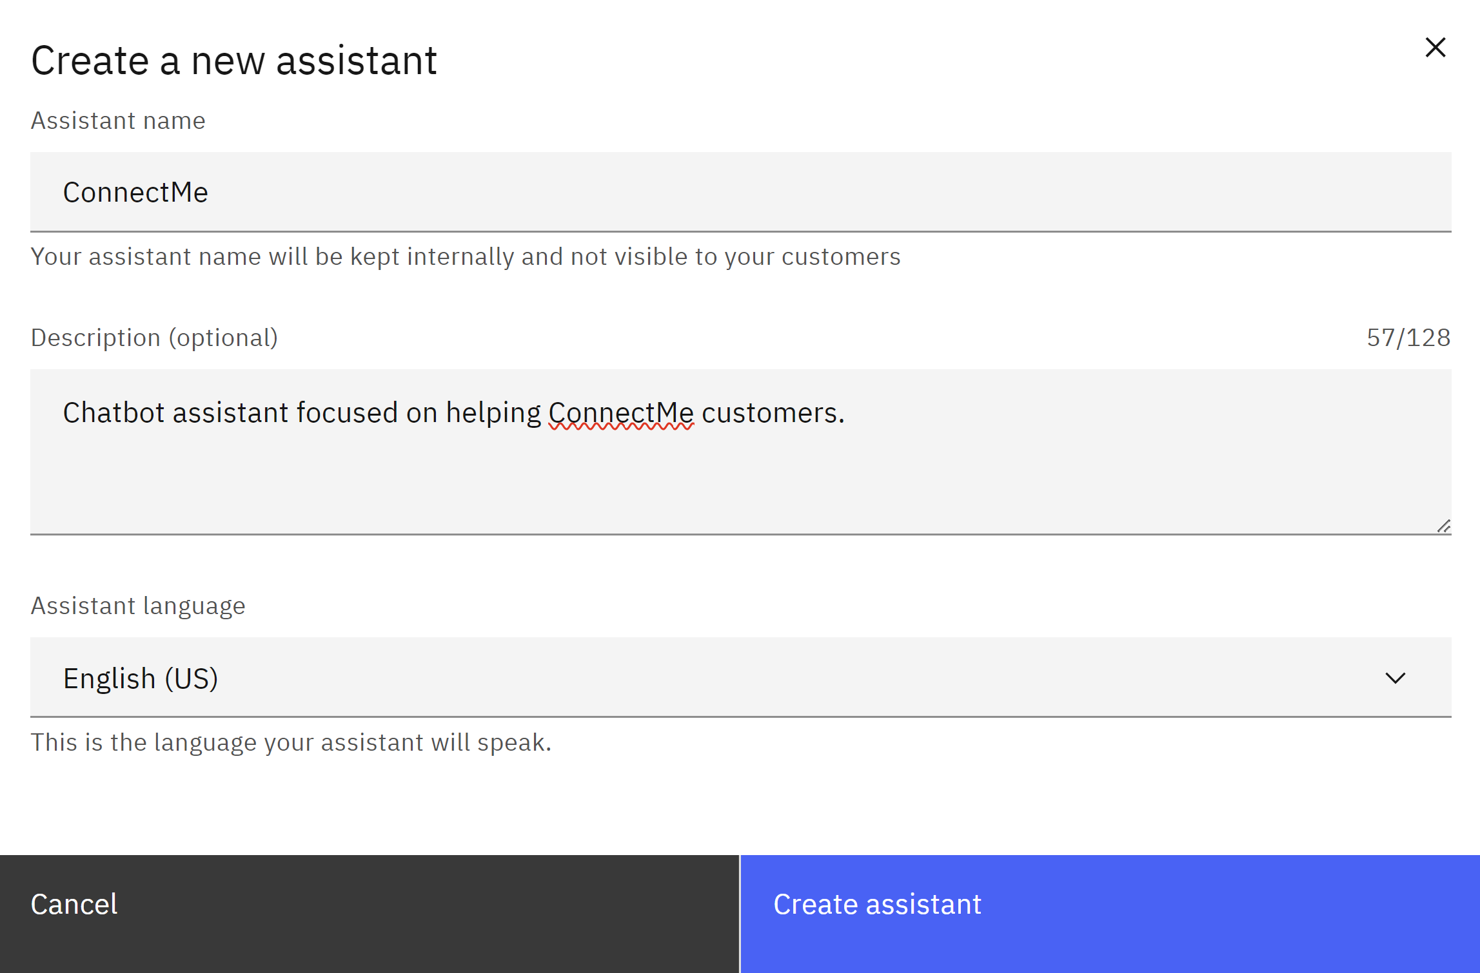
Create Watsonx Assistant
Video Demo: https://www.youtube.com/watch?v=JTcrllB82QE

Slide 16
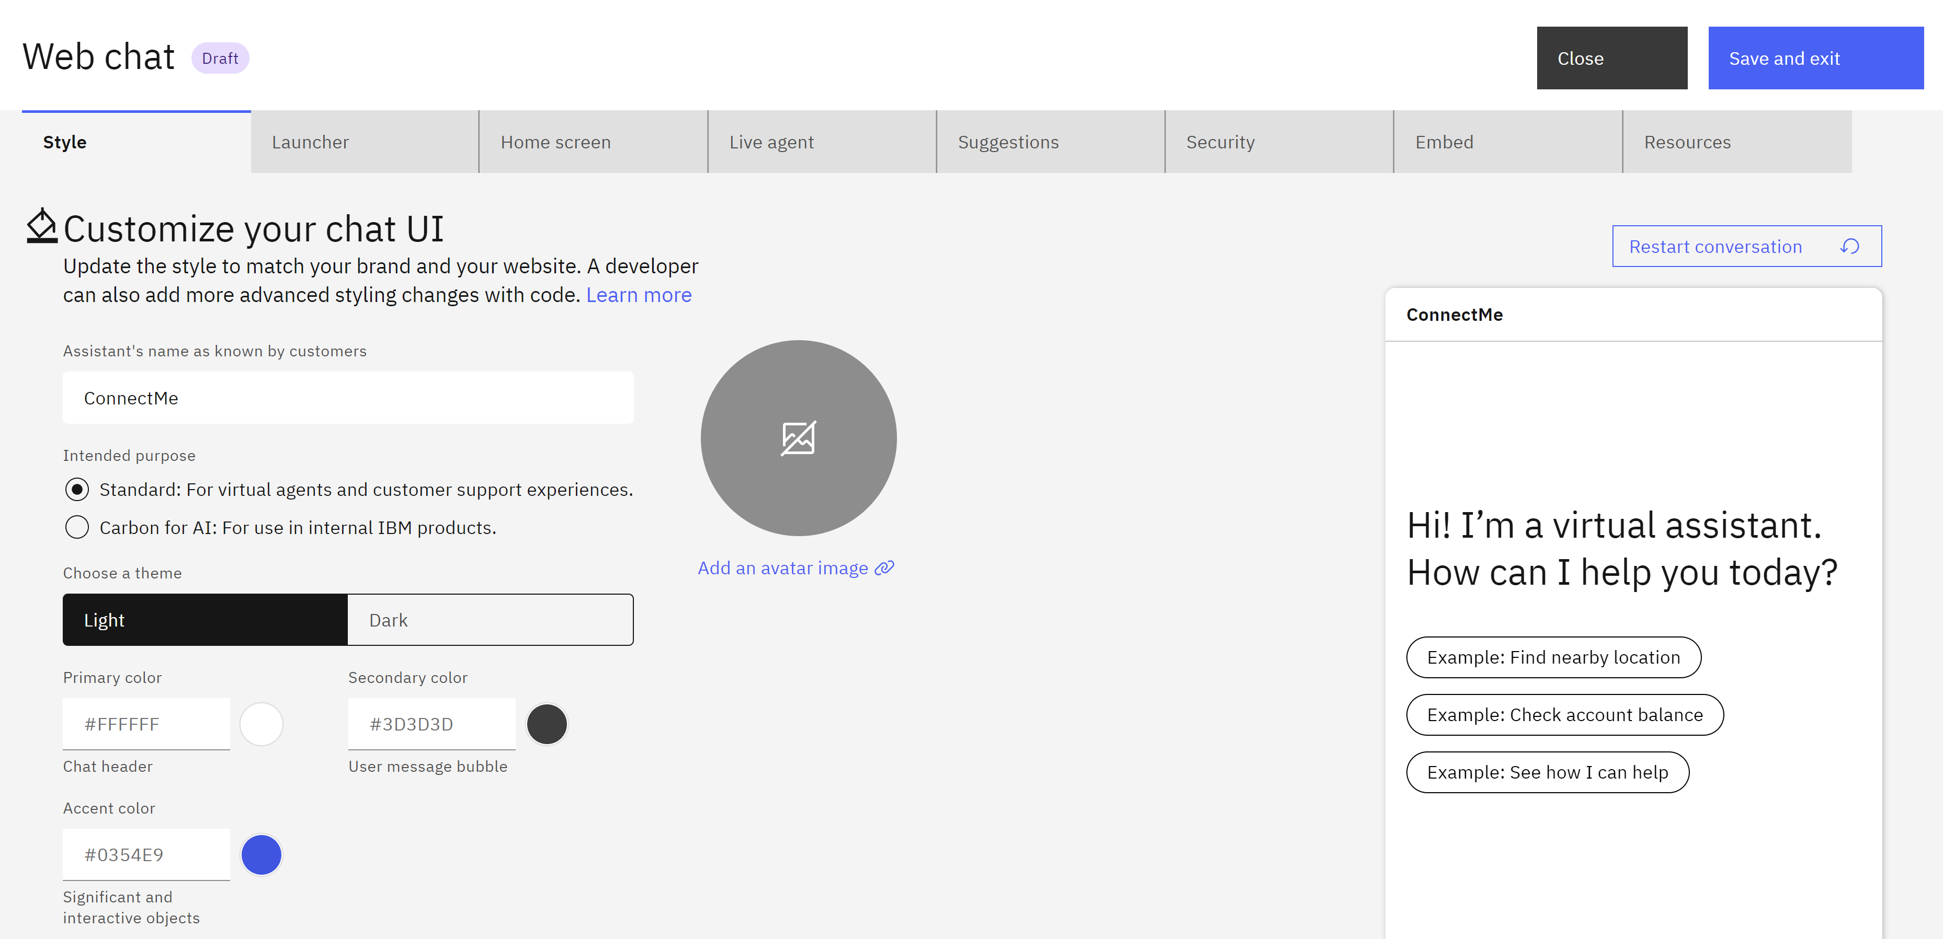
Customize Web Chat

Slide 17
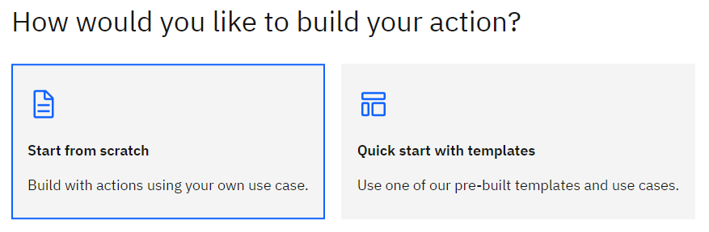
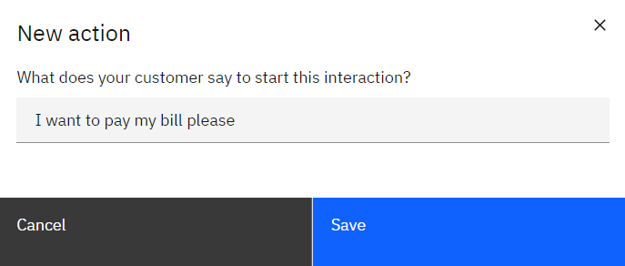
Create Action From Scratch and Set Initial Phrase

Slide 18
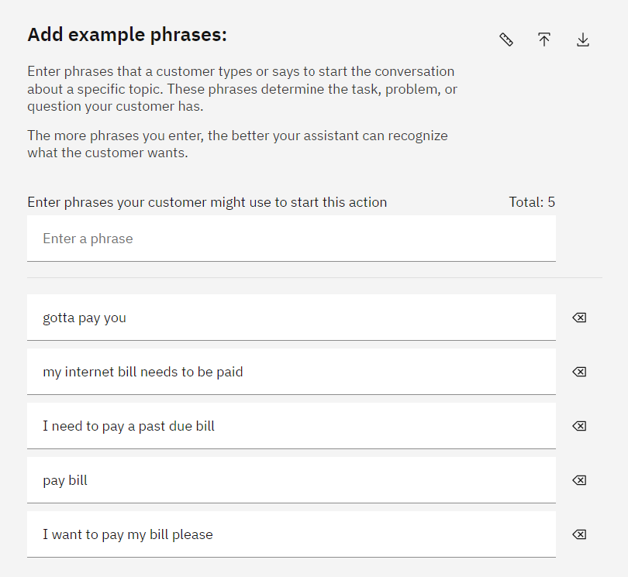
Add More Example Phrases
⭐

Slide 19
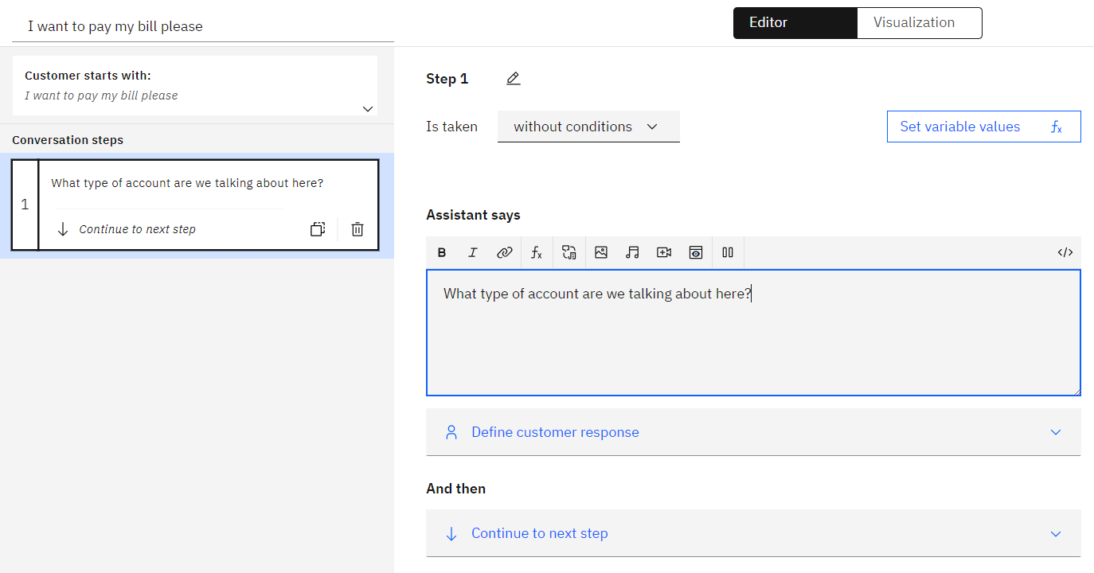
Create First Step

Slide 20
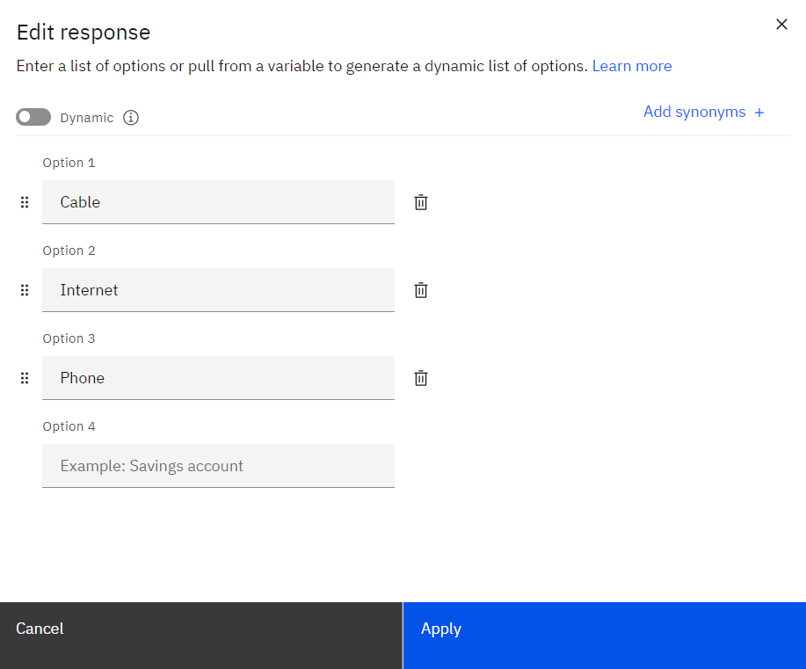
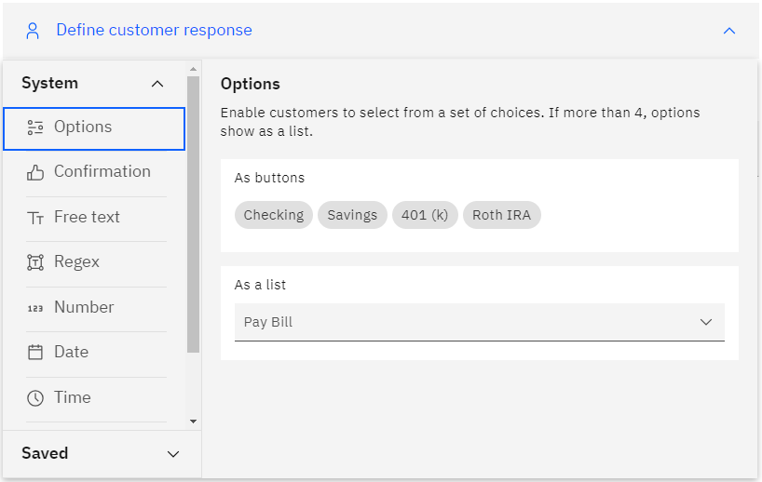
Add Custom Response Options

Slide 21
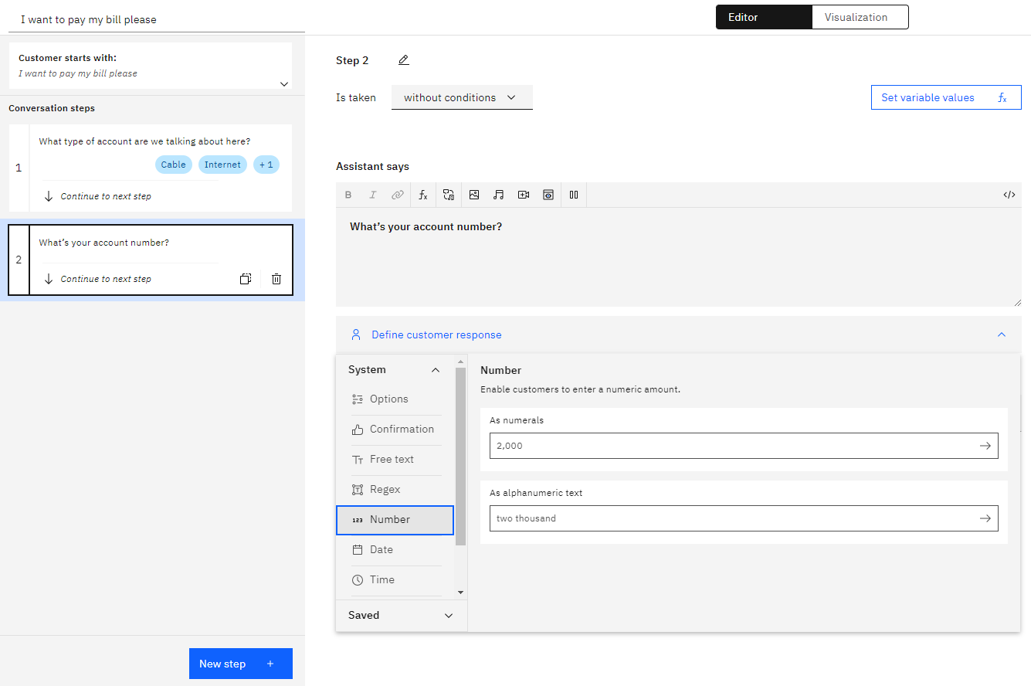
Create Another Clarification Step

Slide 22
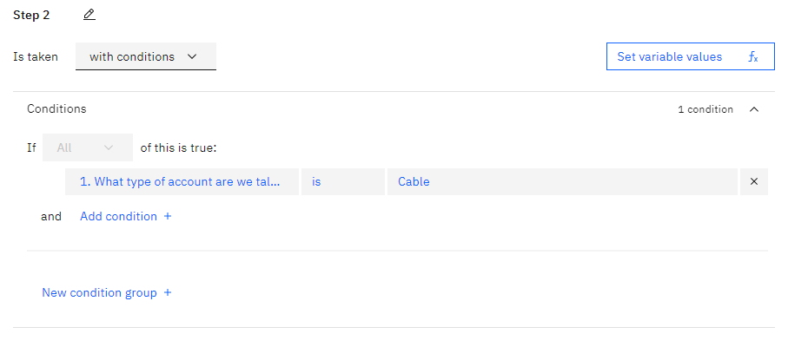
Add Condition

Slide 23
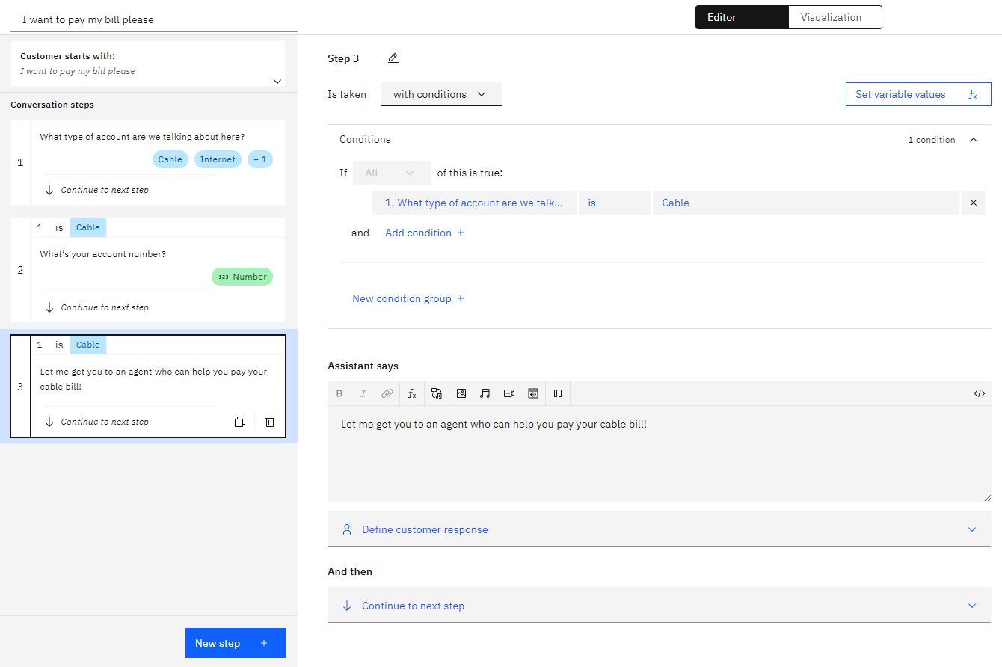
Create an Agent Handoff Step

Slide 24
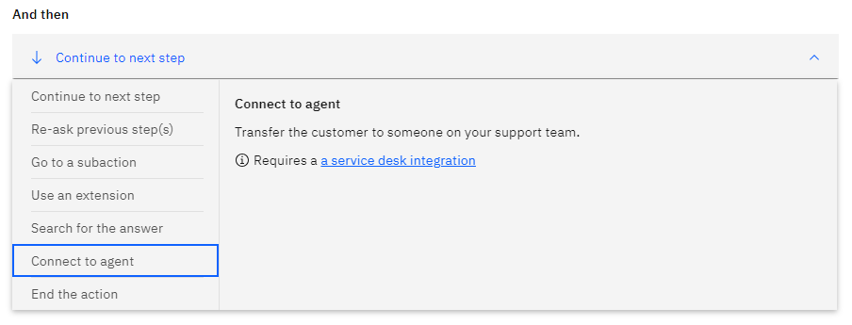
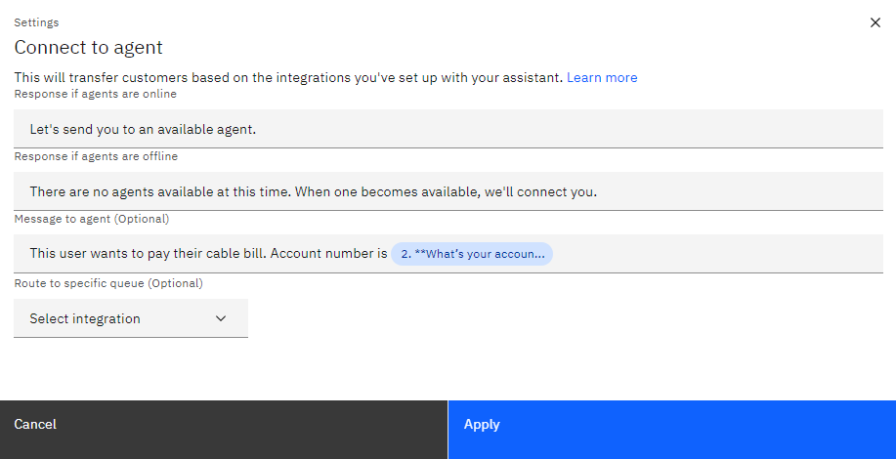
Connect to Agent

Slide 25
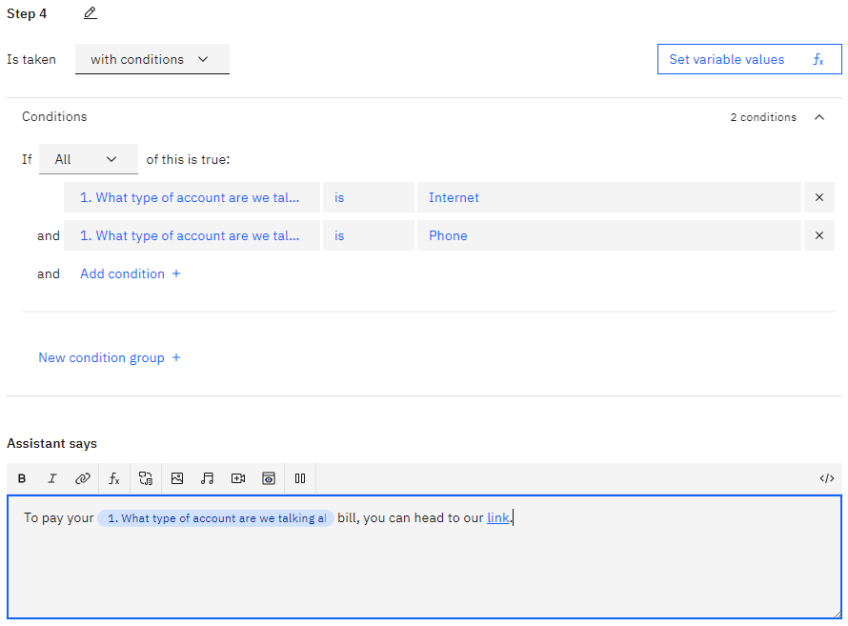
Create Final Response Step

Slide 26
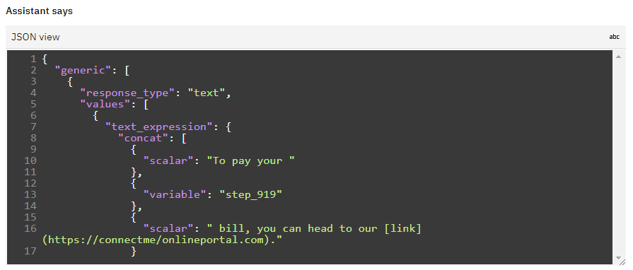
Edit Response in JSON View

Slide 27
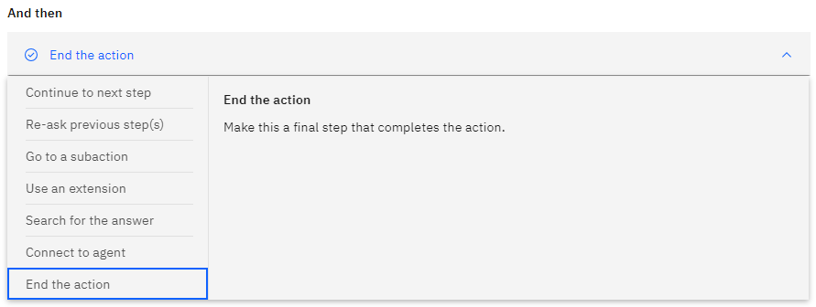
End the Action

Slide 28
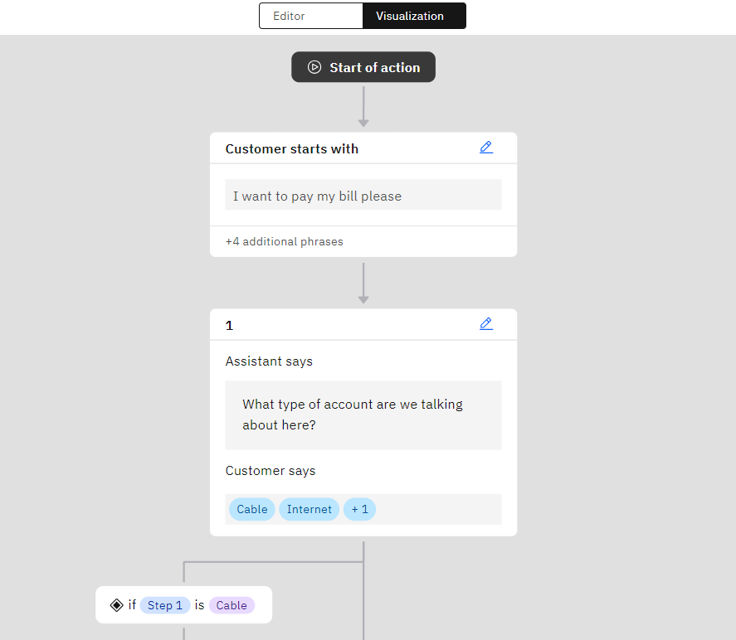
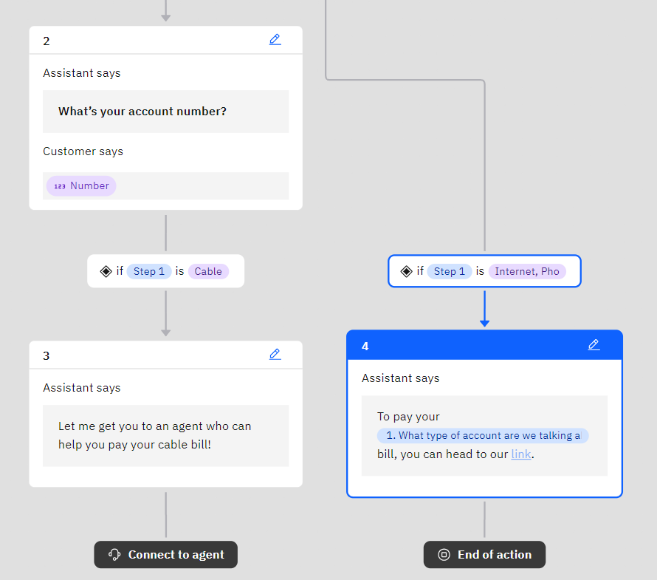
Use Visualization Tool

Slide 29
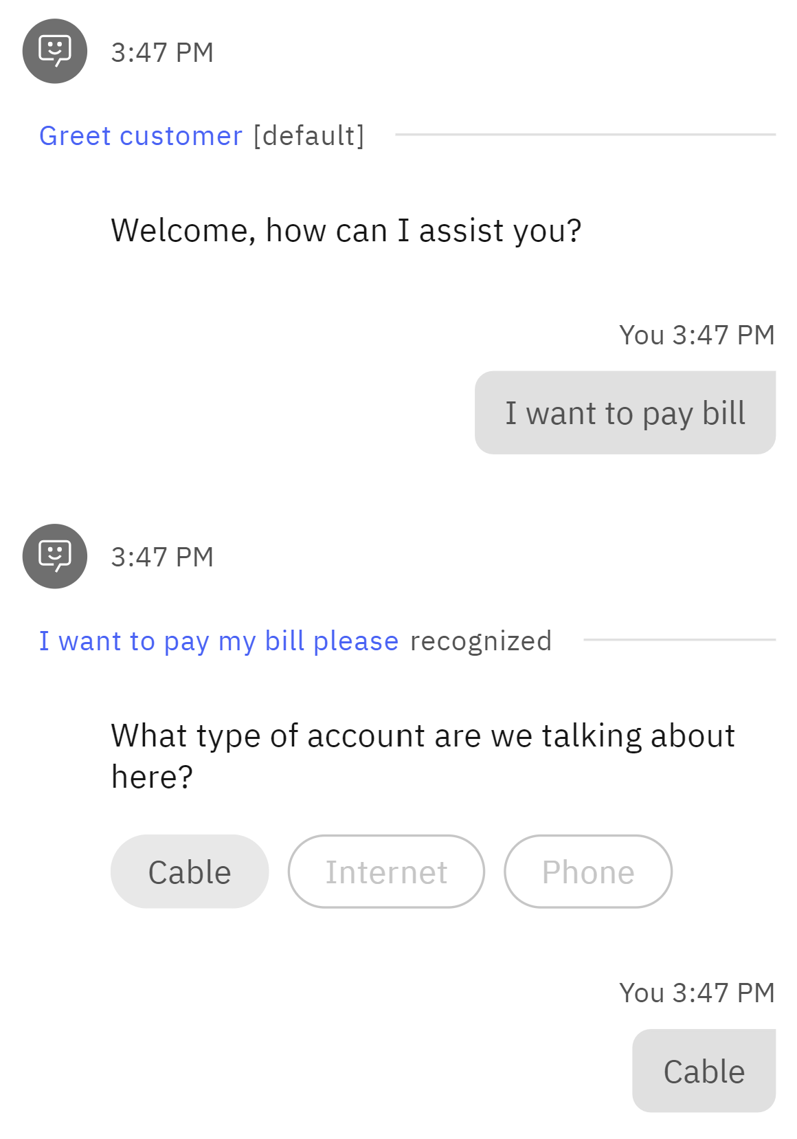
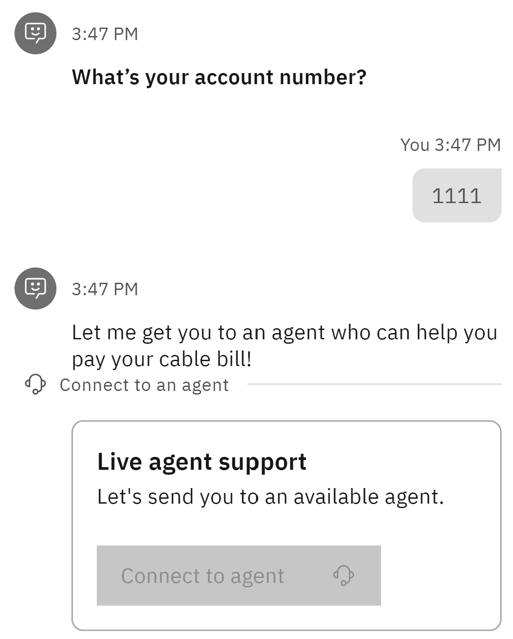
Preview Your Action

Slide 30
Integrate with Db2

Slide 31
Have you ever used Mapepire?
Choose 1:
Yes, mapepire-java
Yes, mapepire-python
Yes, mapepire-js
Yes, more than one of the above SDKs
No, but heard of it
No, never heard of it

Slide 32
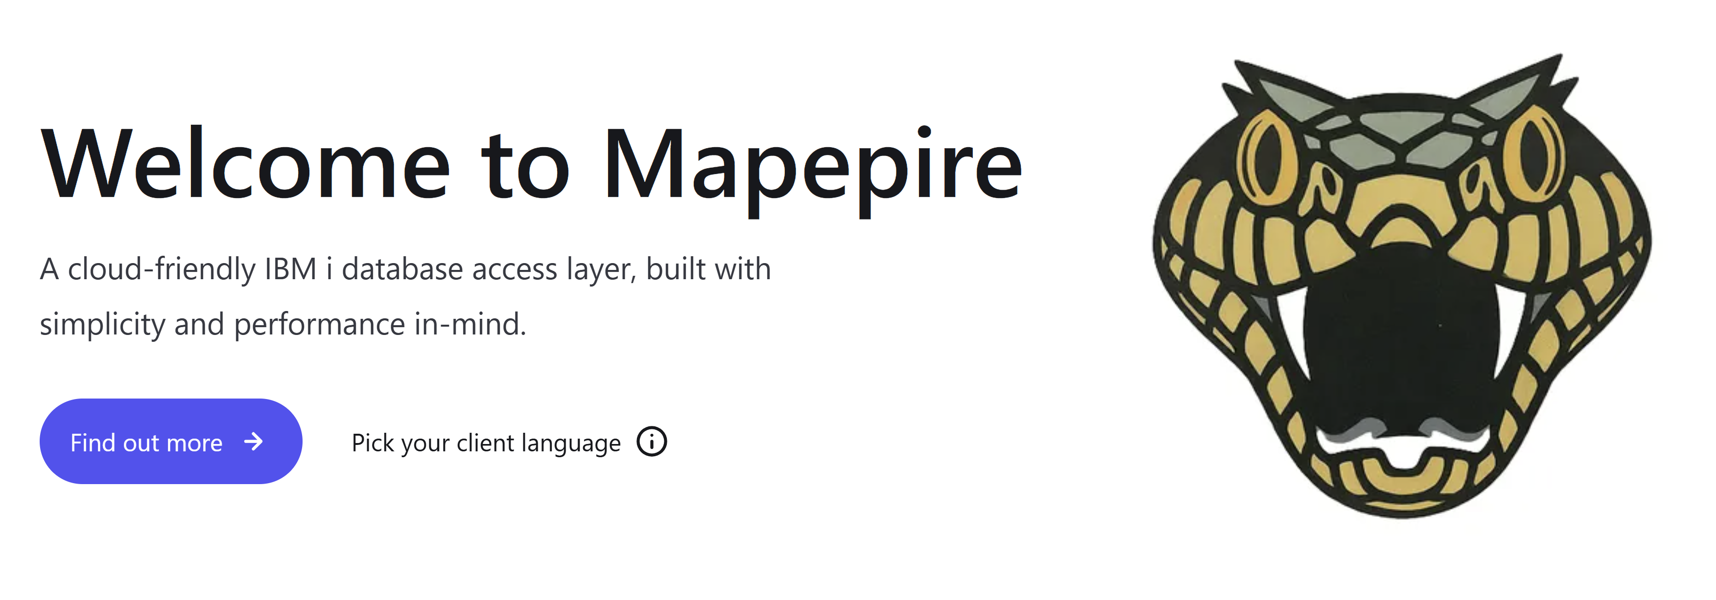

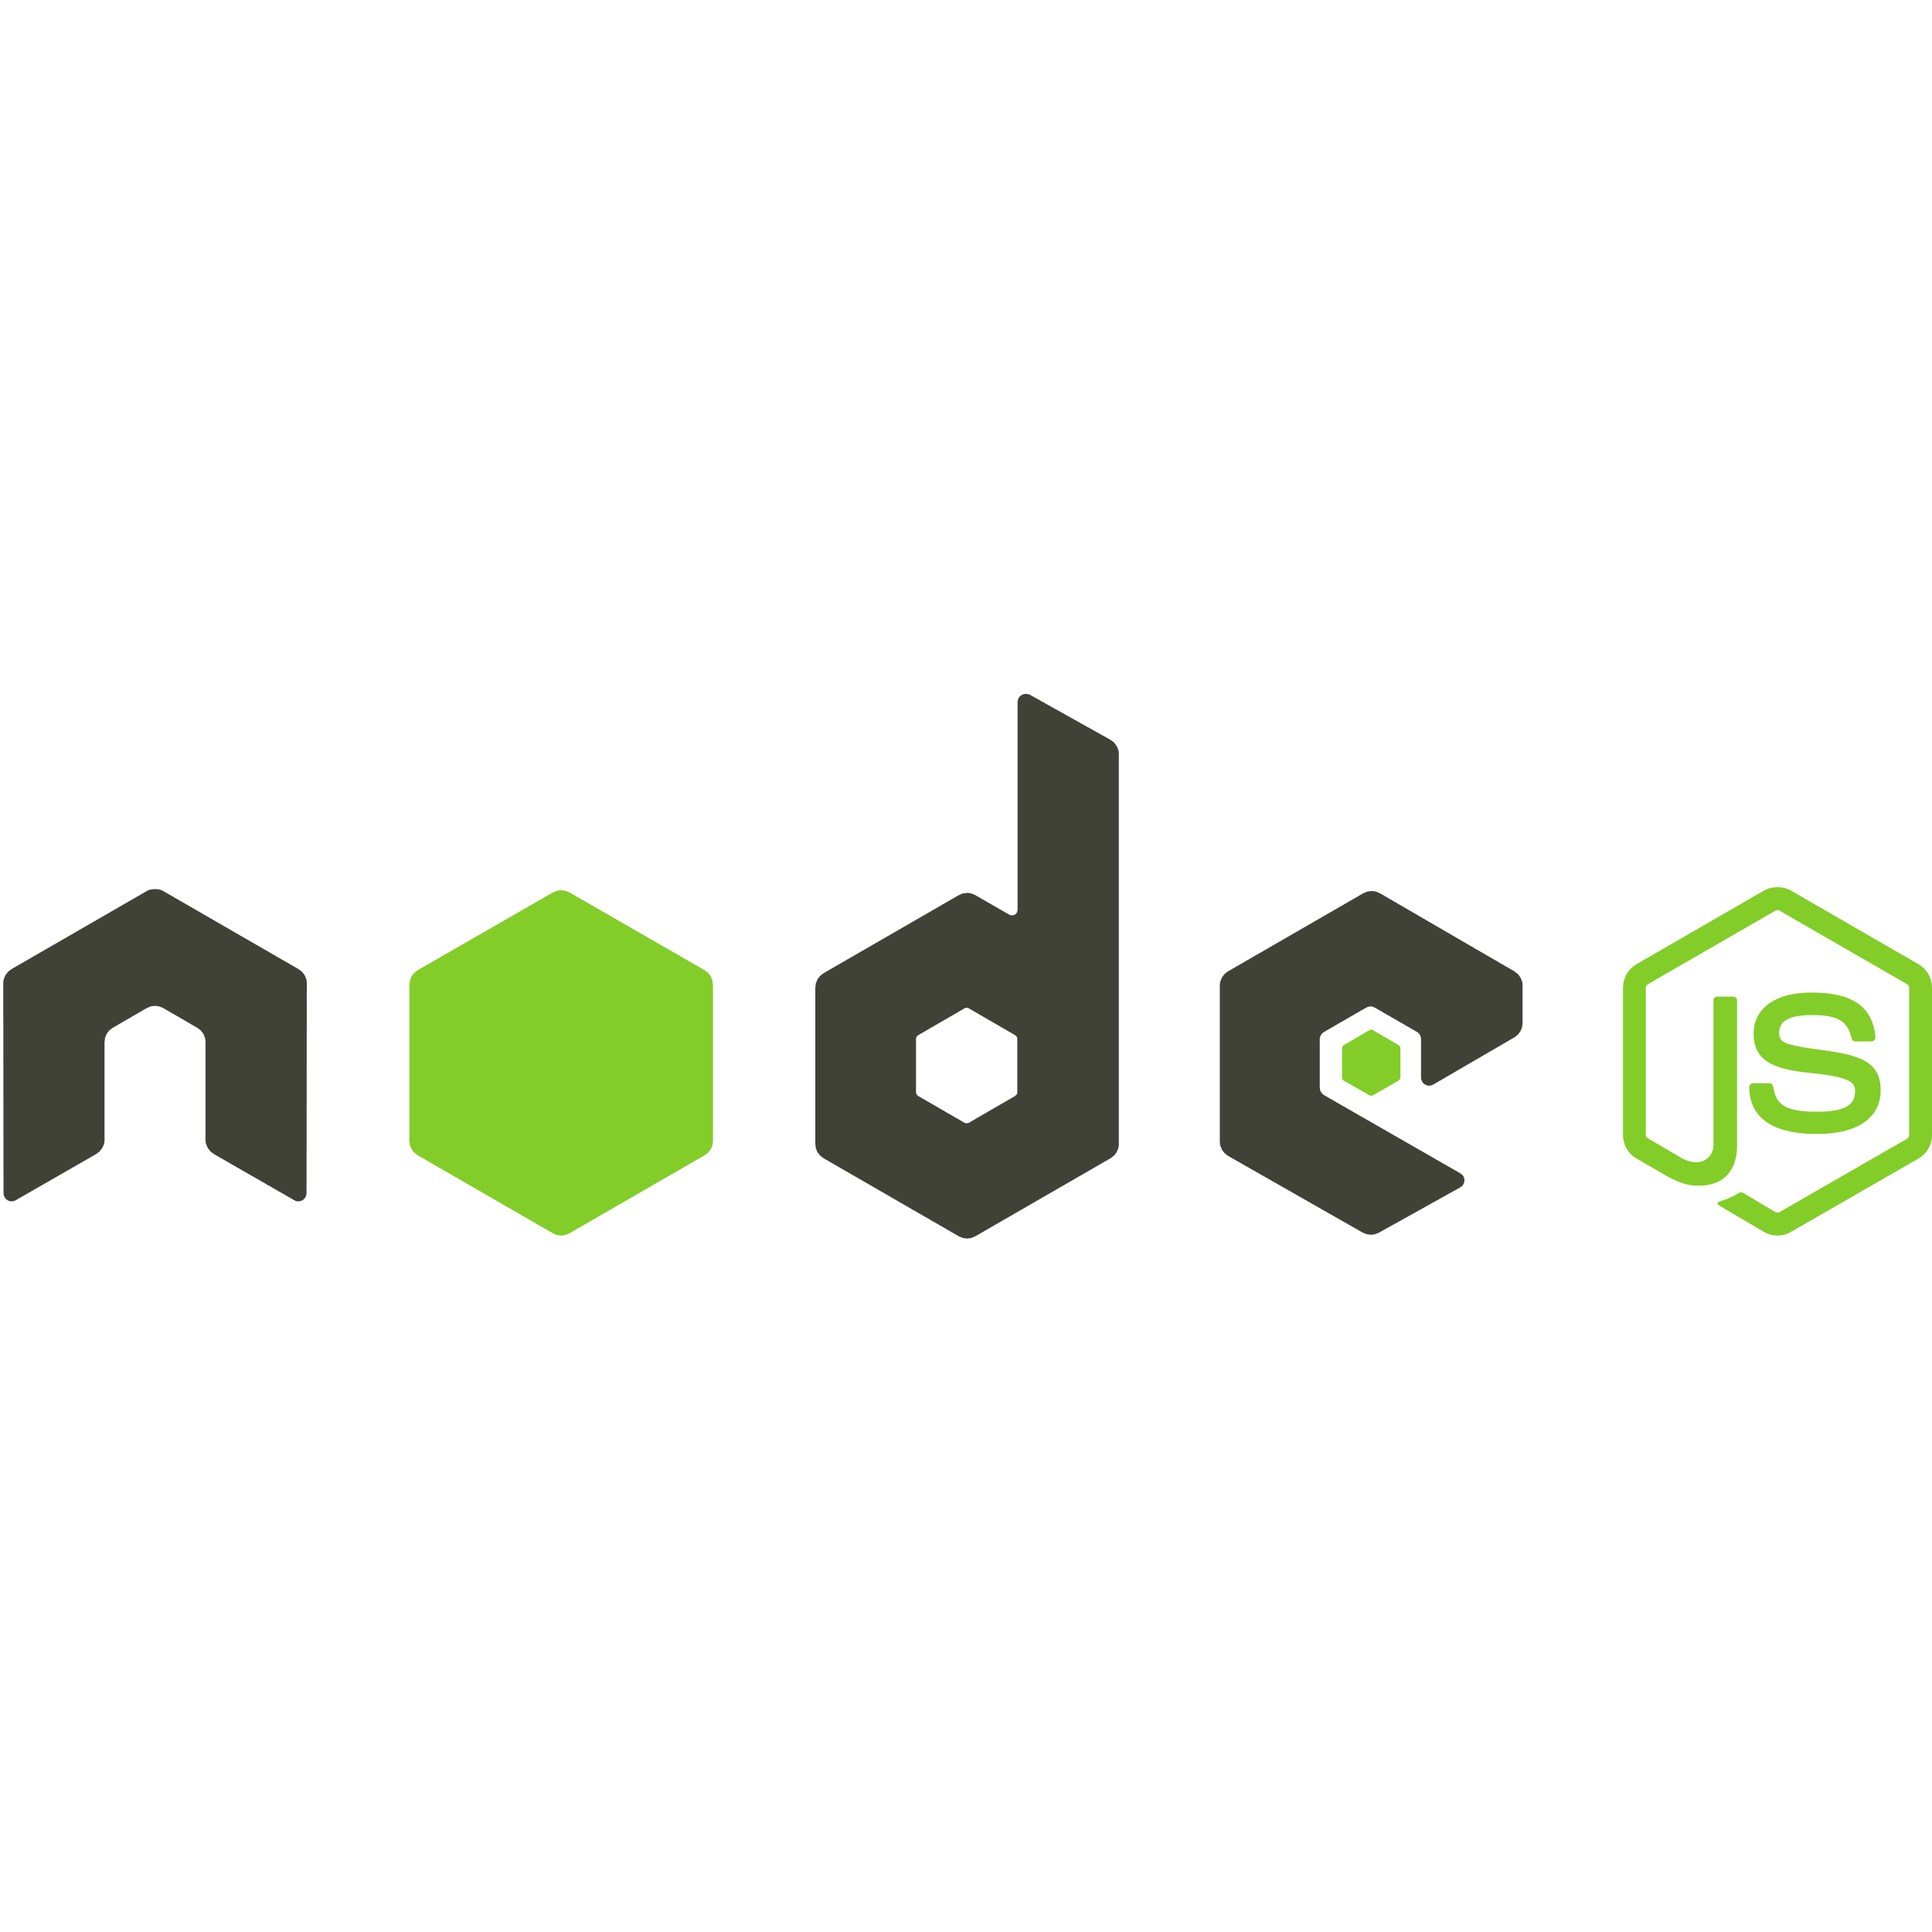
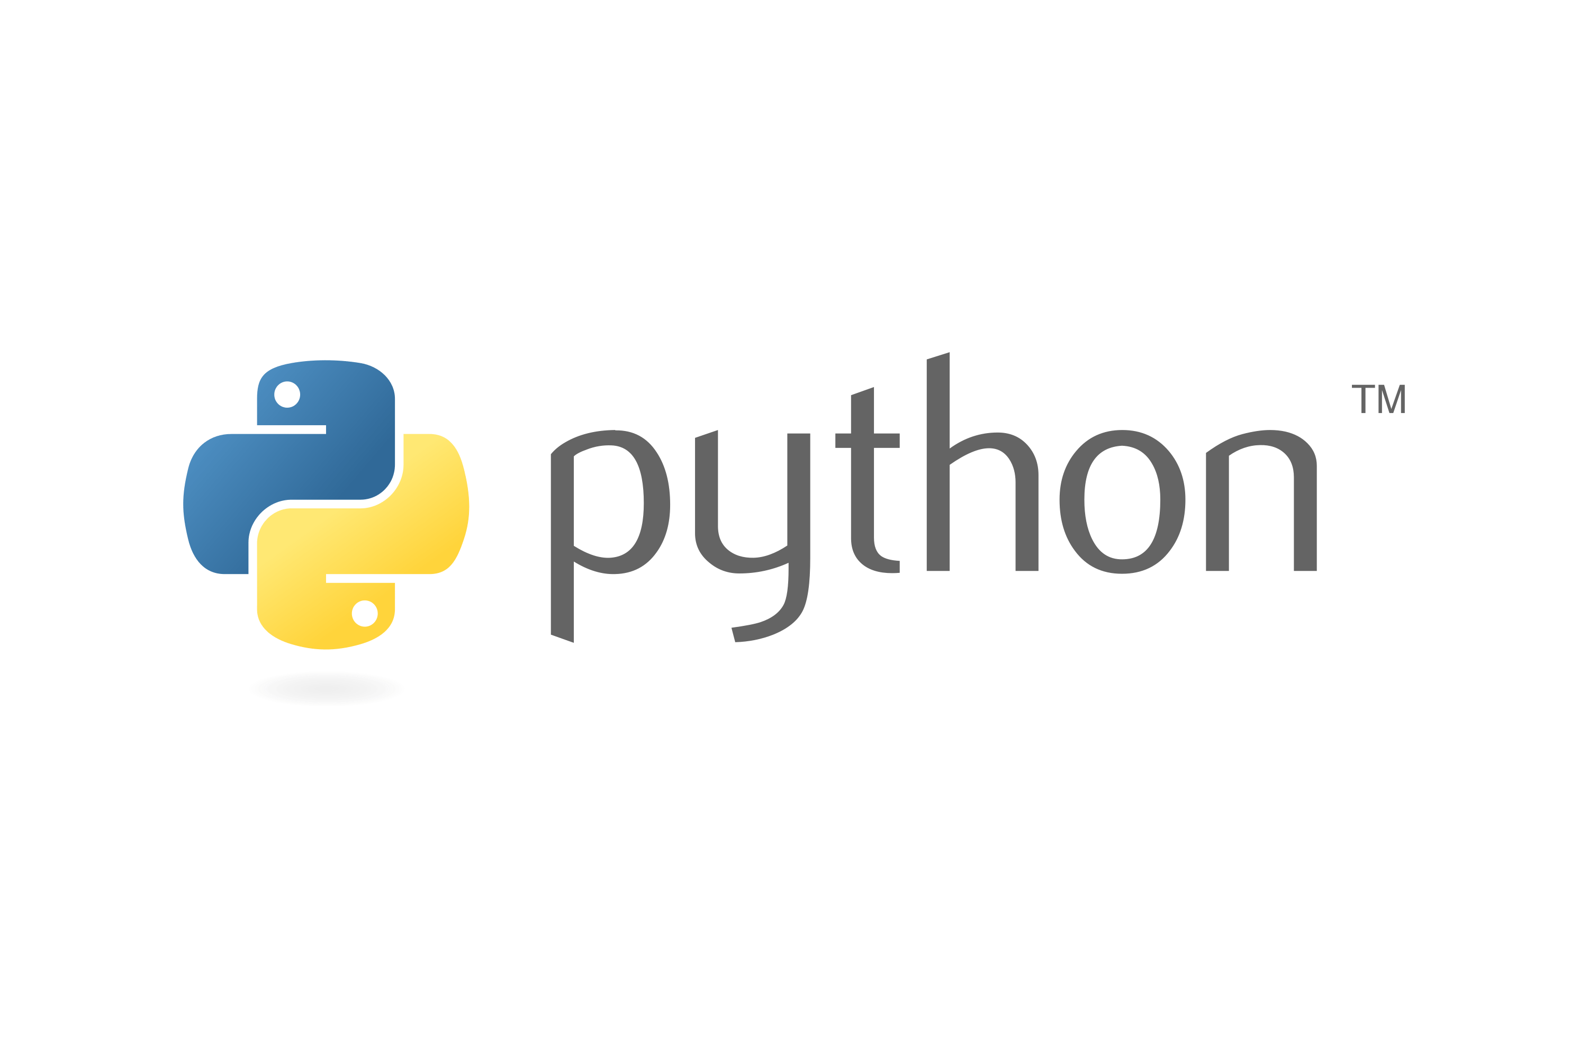


What is Mapepire?
Super easy to use way to access Db2 for i from any application

Slide 33
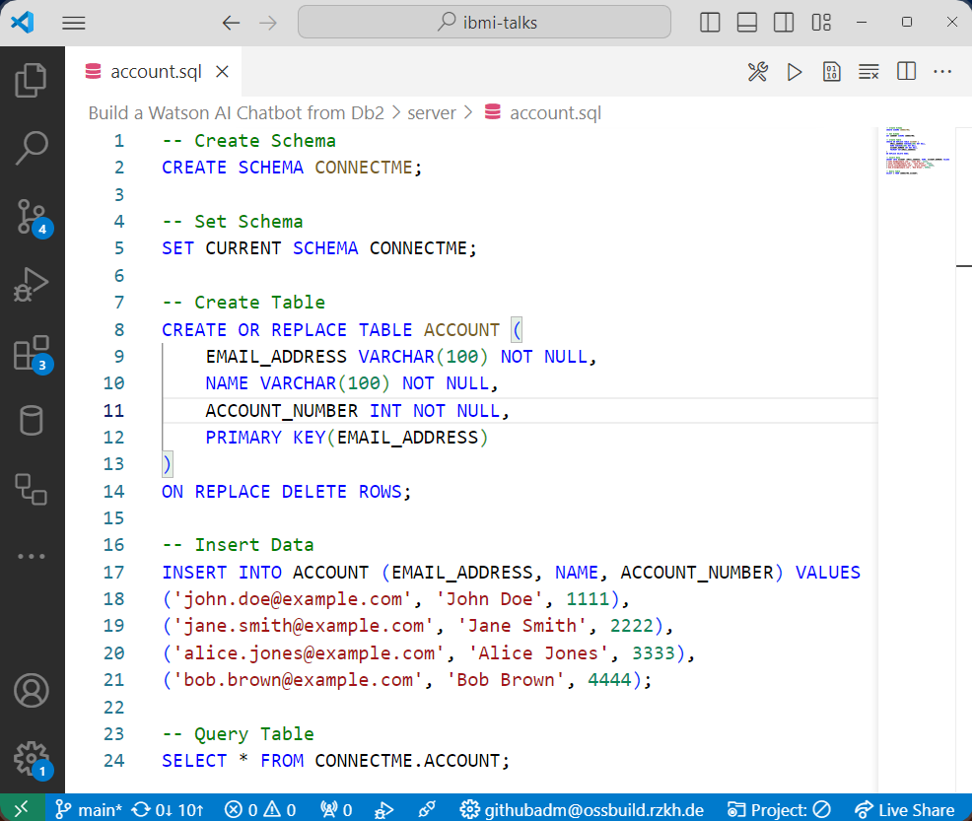
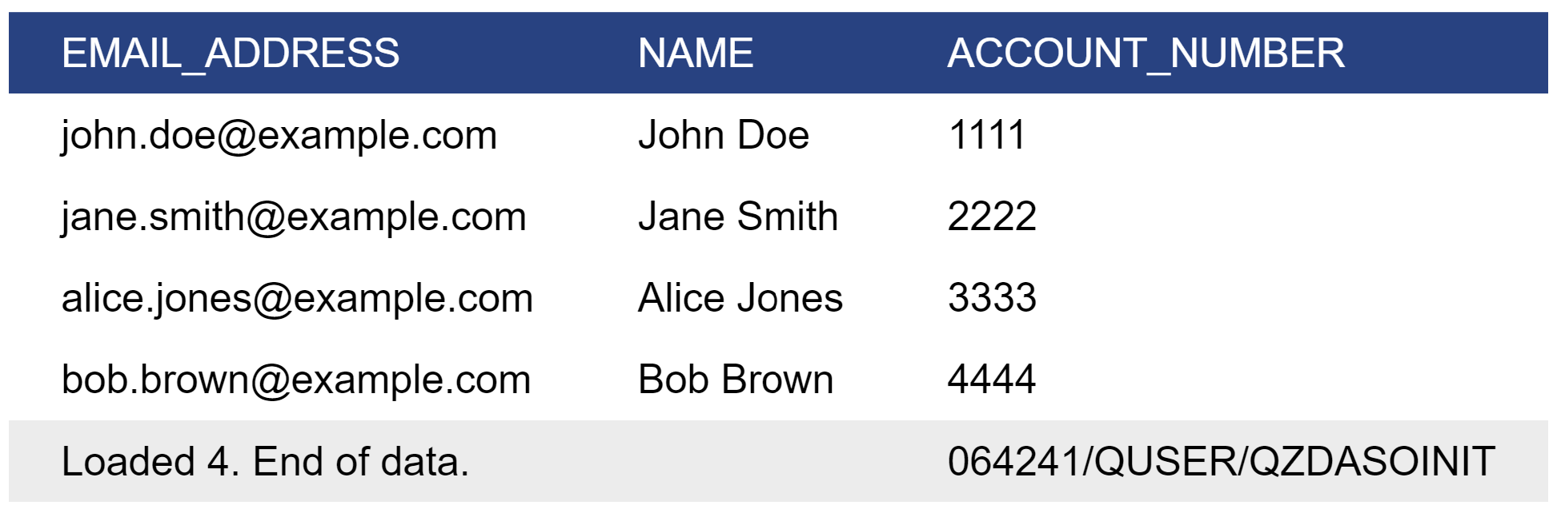
Create Table
Video Demo: https://www.youtube.com/watch?v=RmDchLsPc18

Slide 34
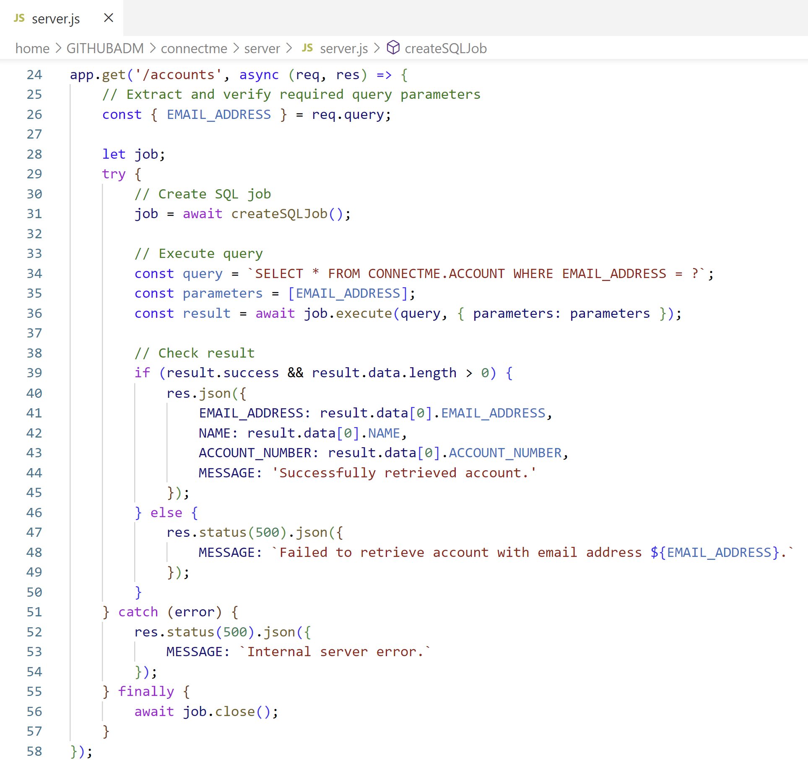
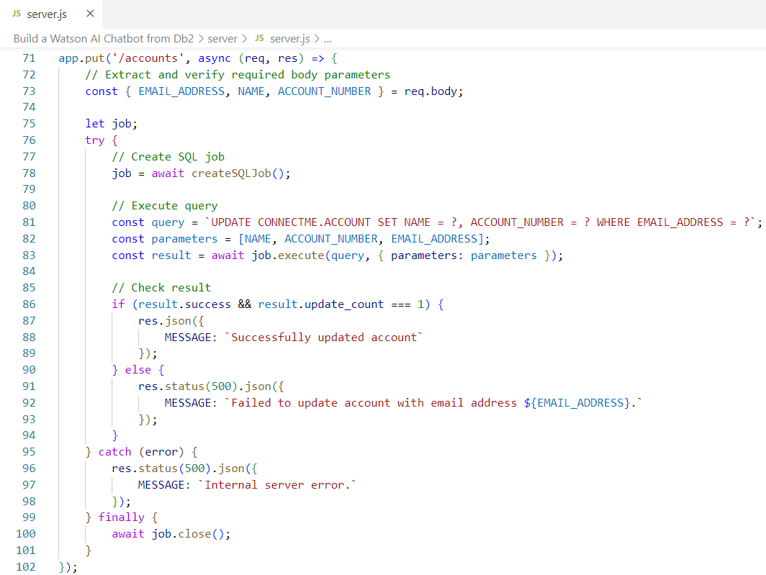
Create REST Server
👨🏻‍💻Server Source Code: server.js
SELECT * FROM CONNECTME.ACCOUNT WHERE EMAIL_ADDRESS = ?
UPDATE CONNECTME.ACCOUNT SET NAME = ?, ACCOUNT_NUMBER = ? WHERE EMAIL_ADDRESS = ?

Slide 35
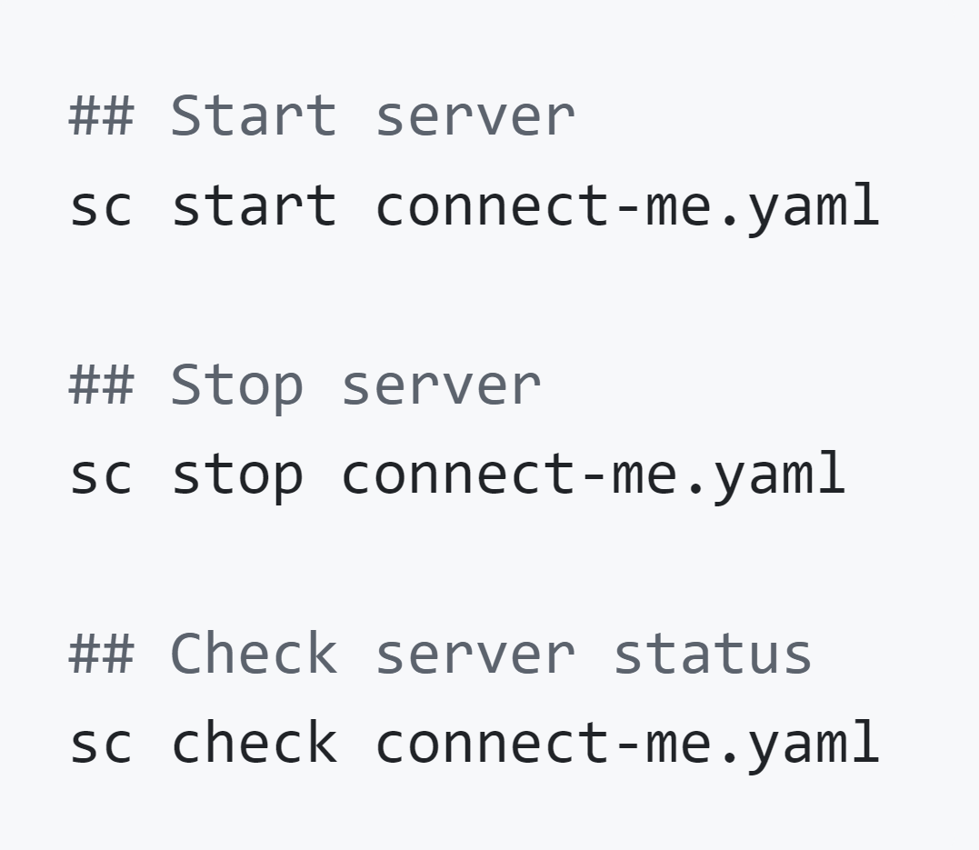
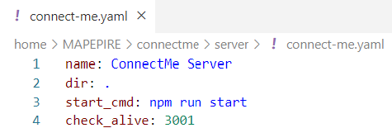
Create Service Commander Definition to Start Server
Service Commander A utility for managing services and applications running on IBM i

Slide 36
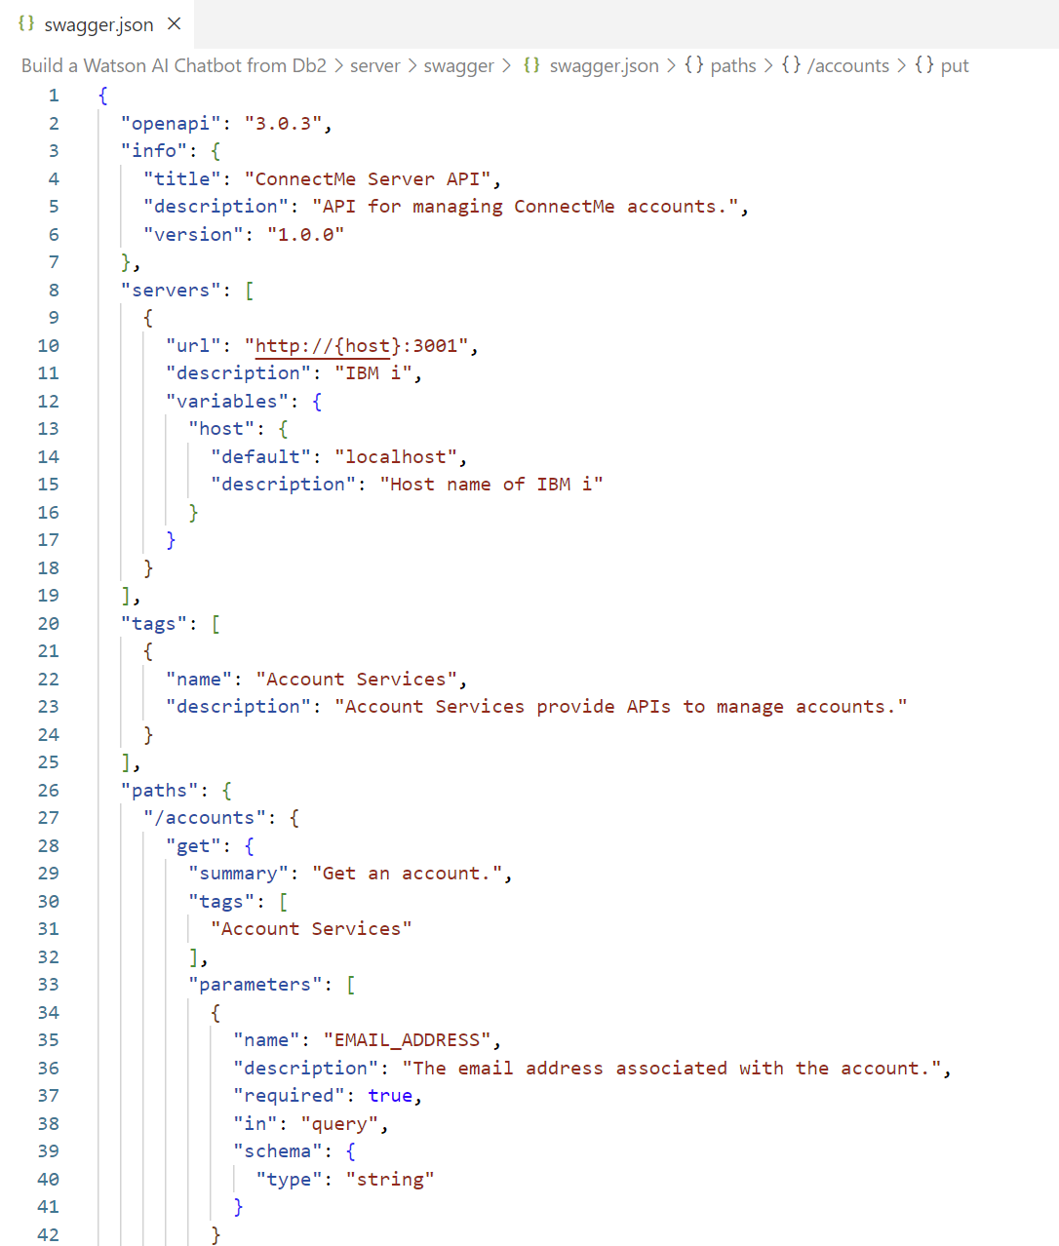
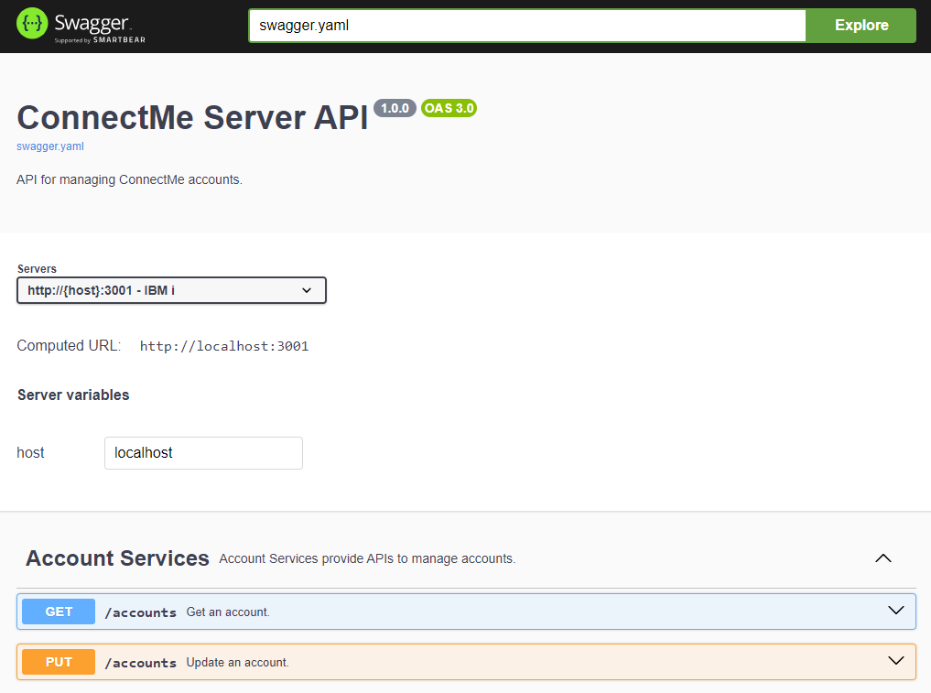
Create OpenAPI Specification (in JSON format)

Slide 37
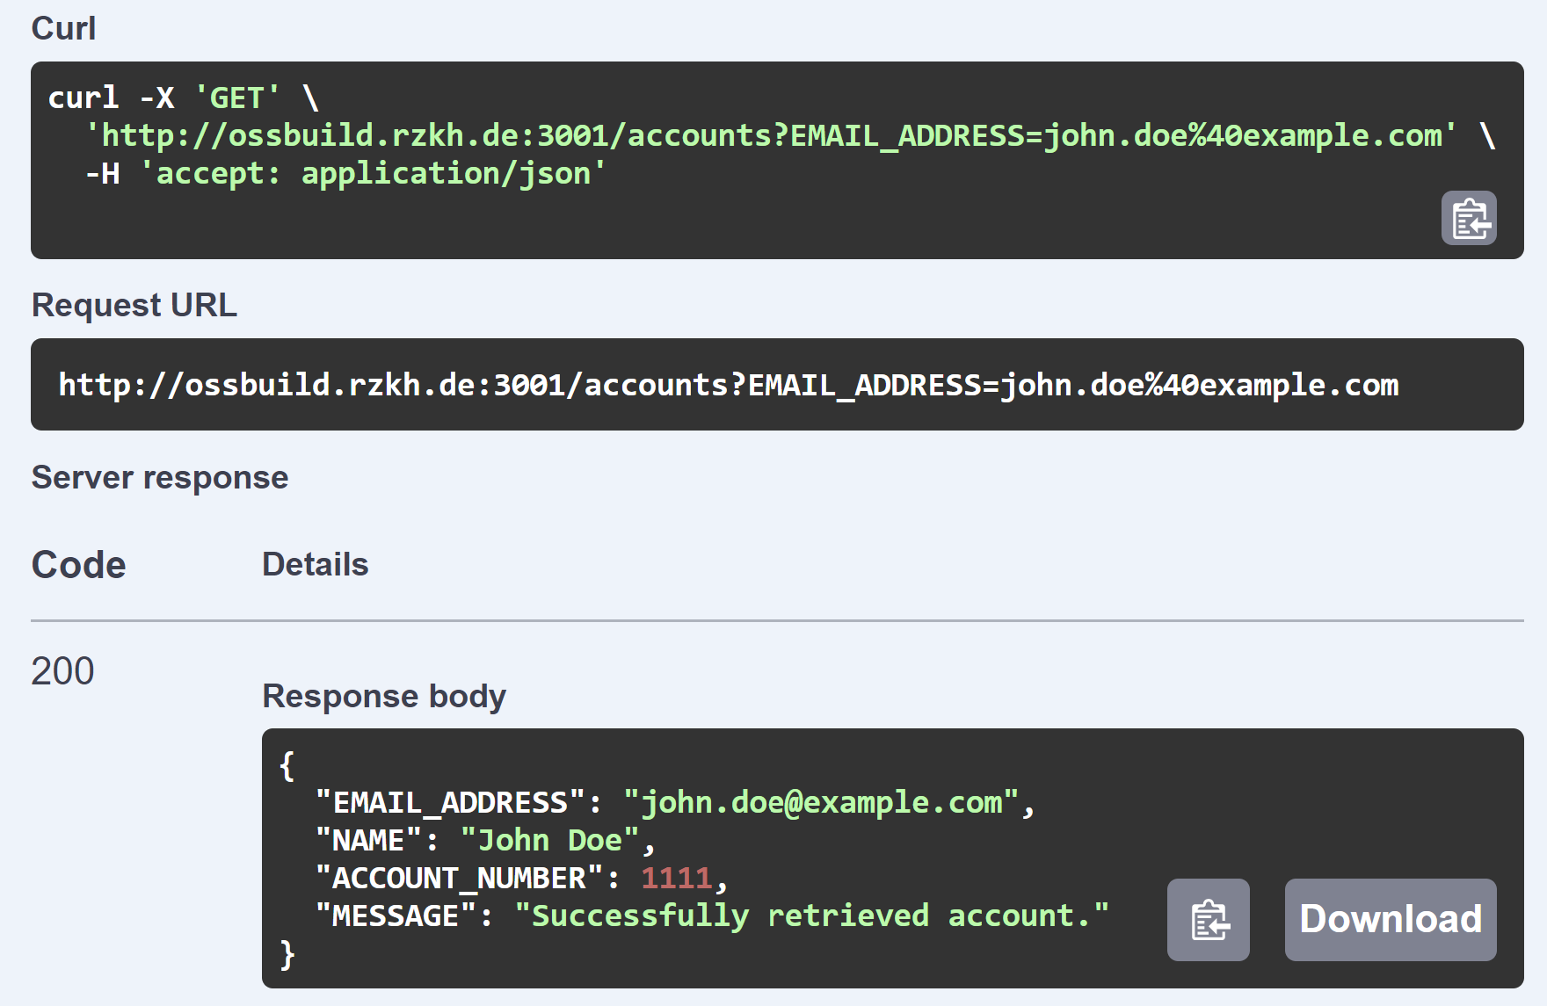
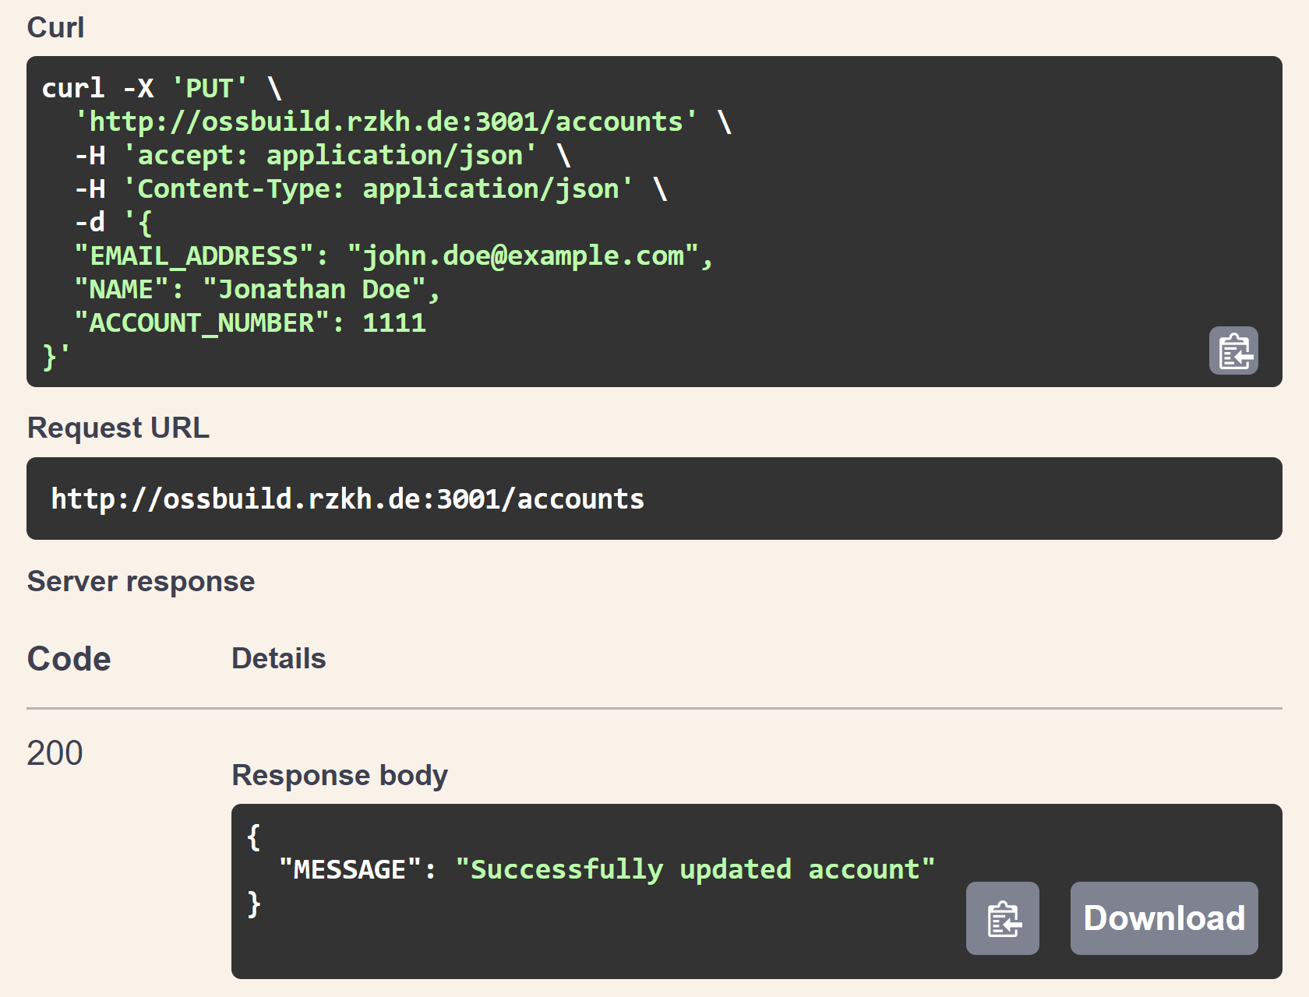
Test OpenAPI Specification

Slide 38
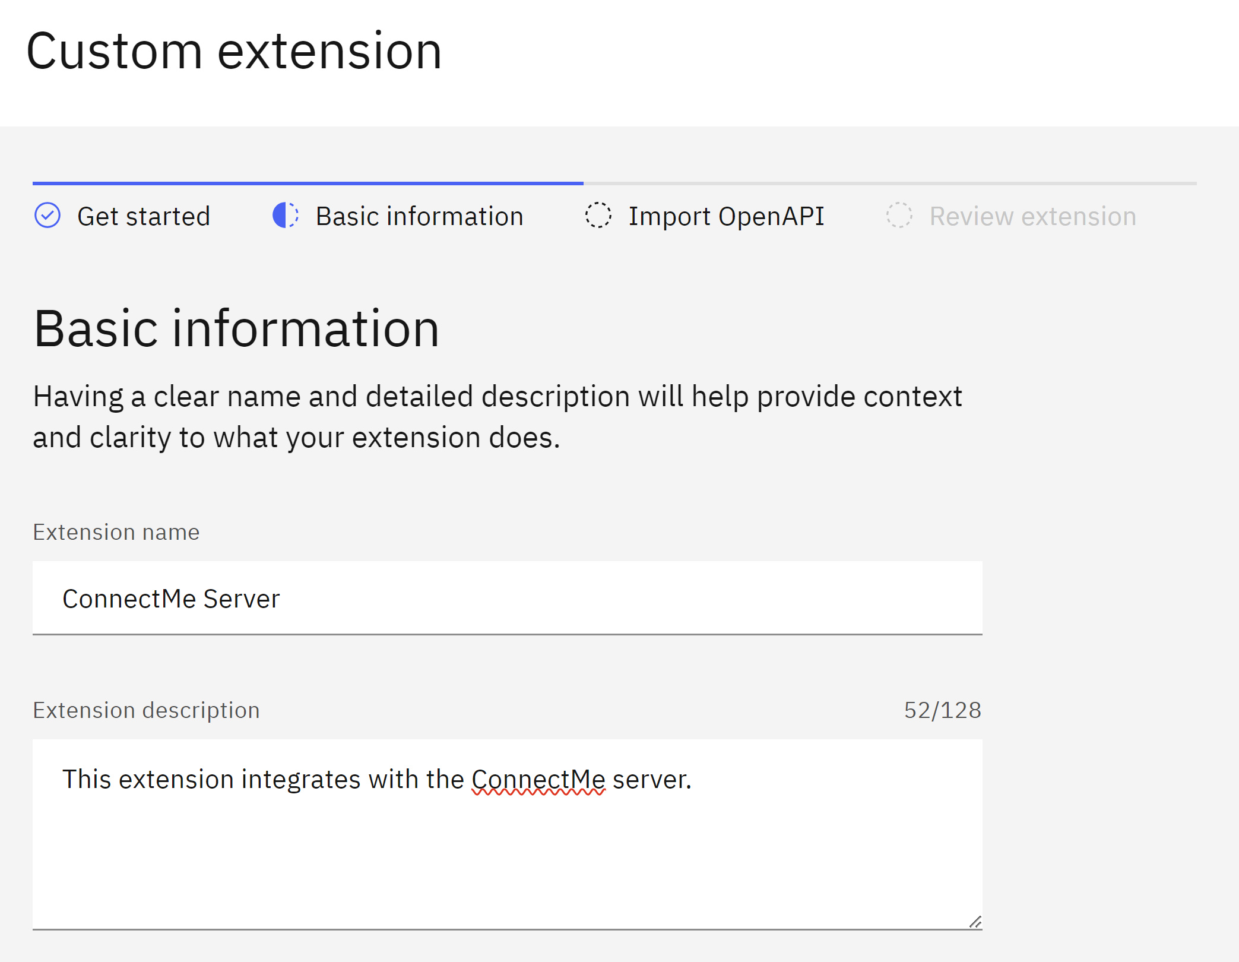
Build Custom Extension

Slide 39
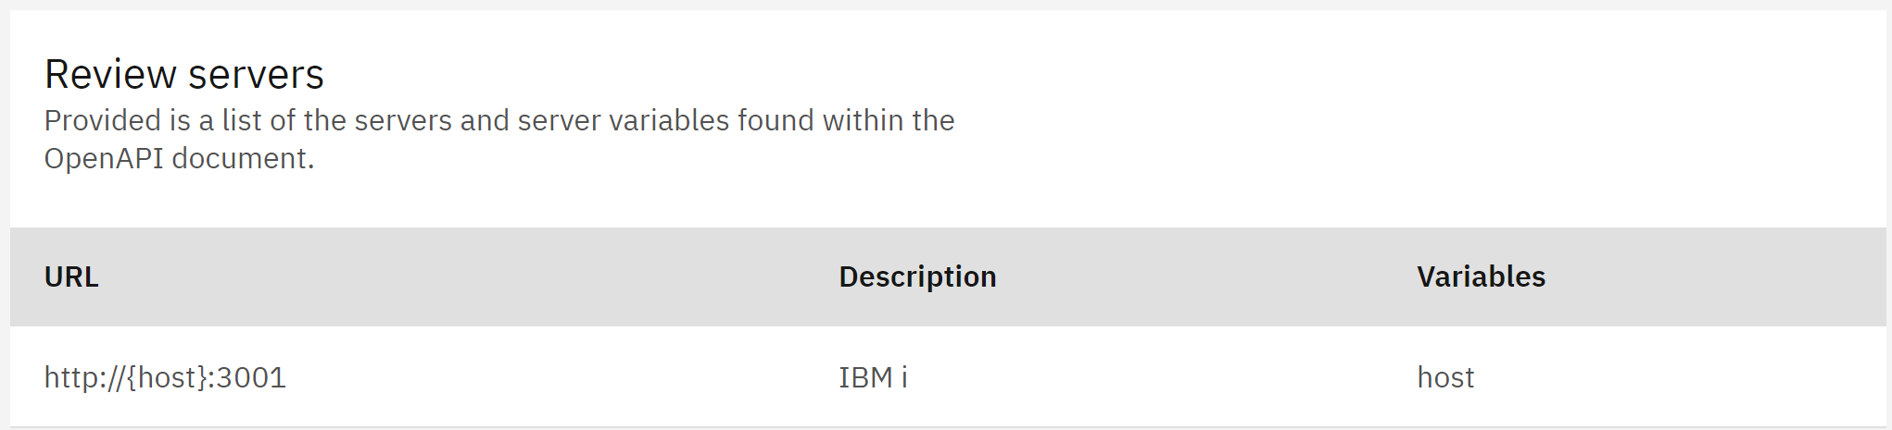
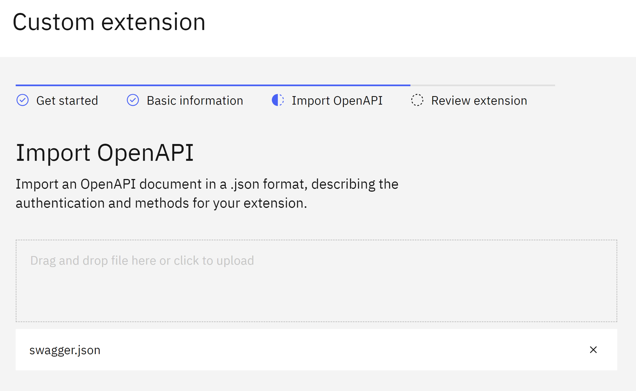
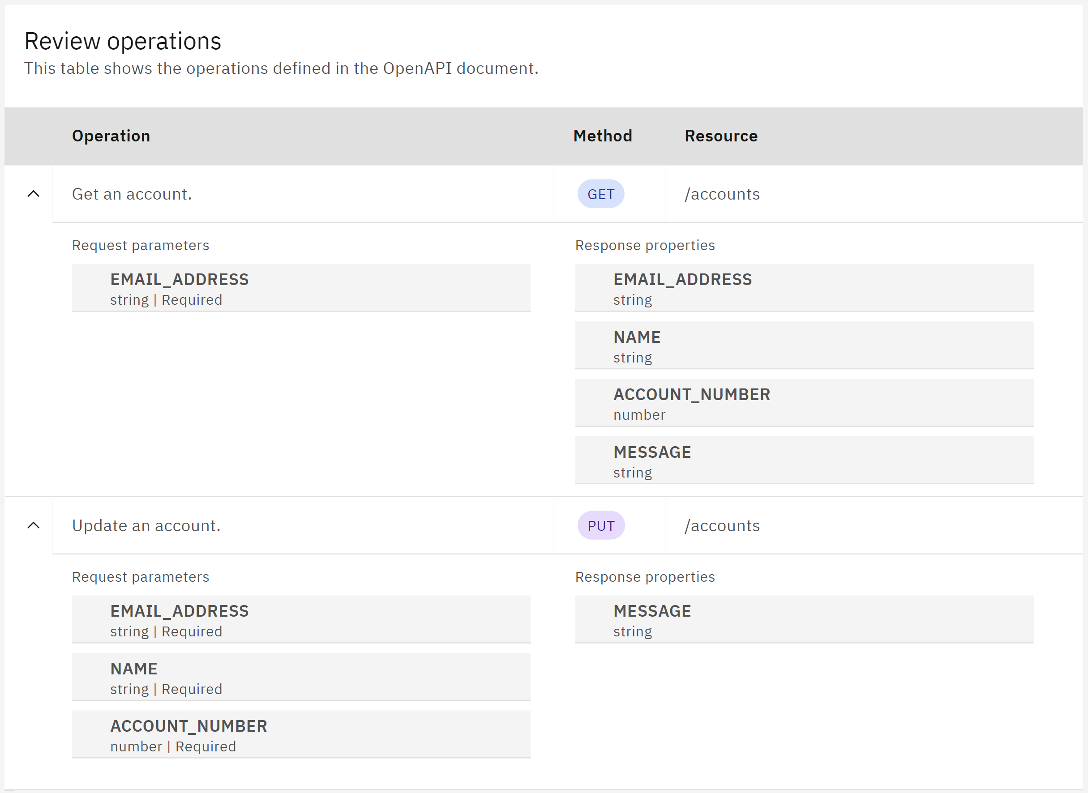
Import OpenAPI Specification

Slide 40
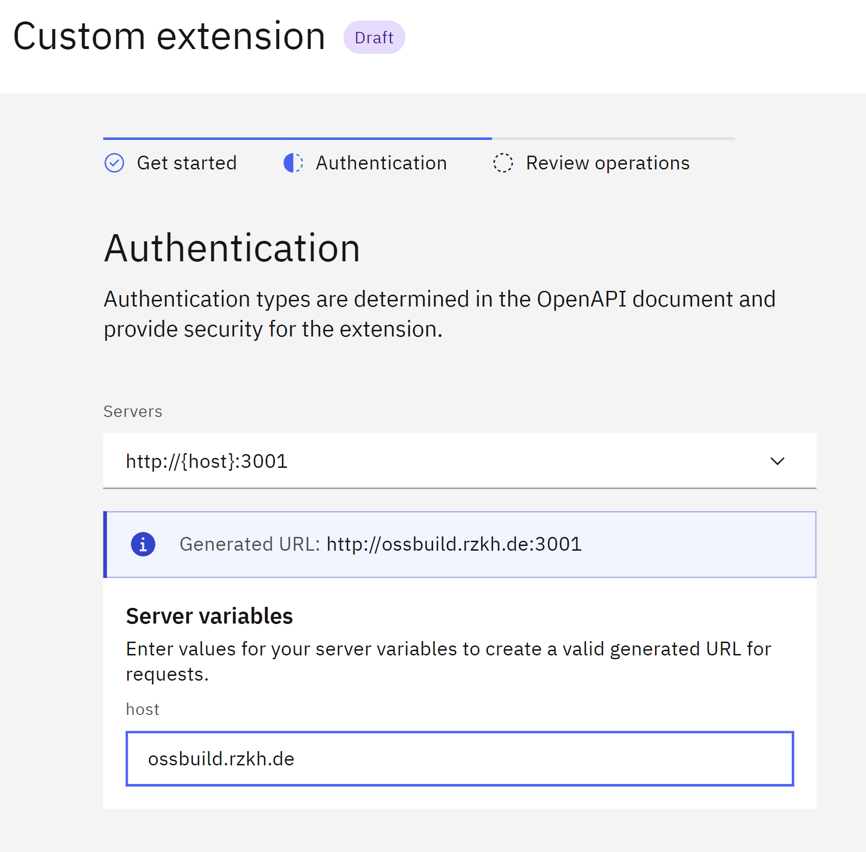
Add Extension to Watsonx Assistant

Slide 41
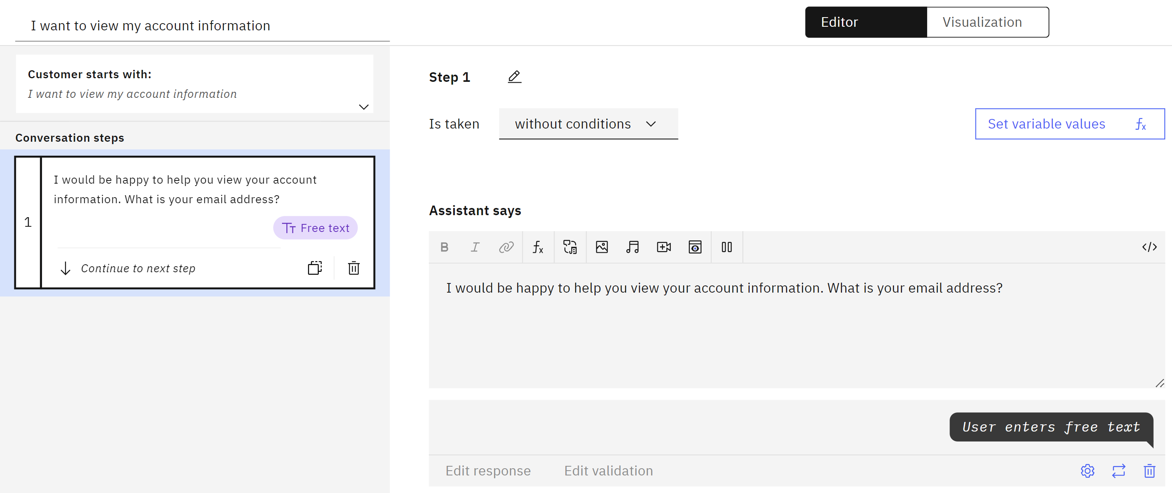
Create New Action with Initial Step

Slide 42
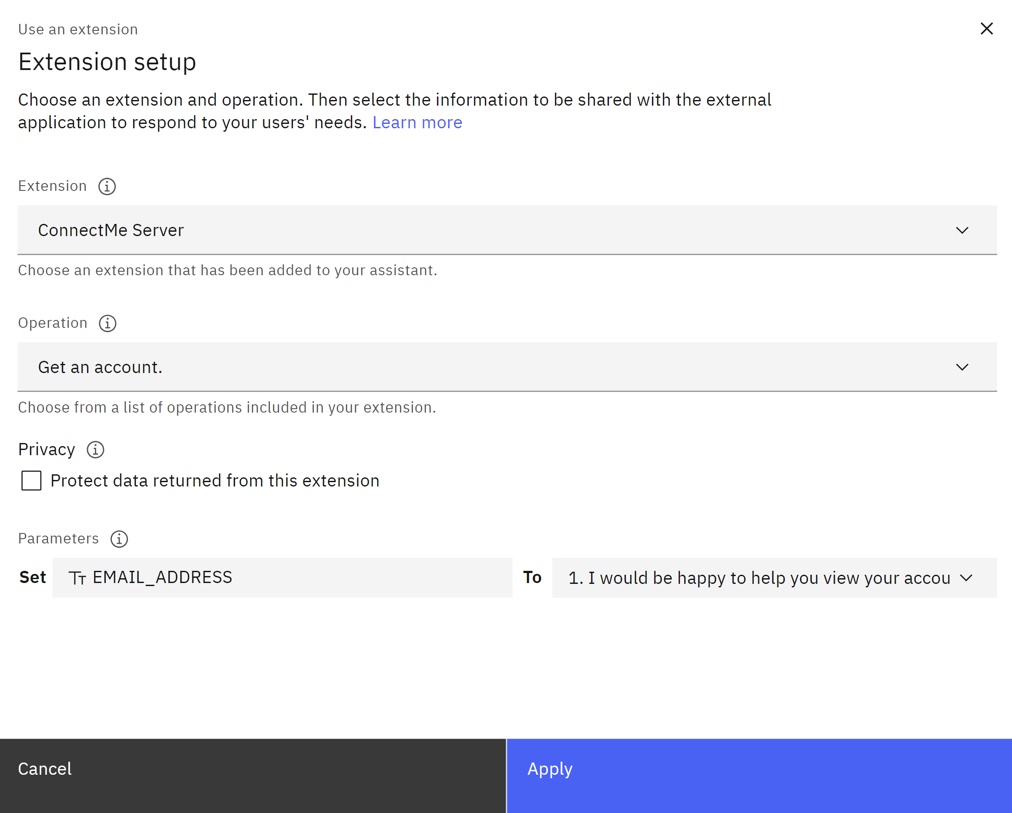

Create Step with Extension

Slide 43


Create Success and Failure Steps
Extension Success
Extension Failure

Slide 44


Preview Your Action

Slide 45


Duplicate Action and Update Phrase + Initial Step

Slide 46

Create Clarification Step

Slide 47


Create Step with Extension

Slide 48

Create Final Step

Slide 49



Preview Your Action

Slide 50
Next Steps

Slide 51

Add More Actions with Templates

Slide 52

Adjust Default Actions

Slide 53



Adjust Global Settings
Clarifying Questions
Show options when multiple actions seem to match what the customer wants
Change Conversation Topics Switch to other actions when customers ask about other topics
Intelligent Information Gathering The assistant retrieves and uses prior inputs to streamline the conversation

Slide 54



Search Integration with Watson Discovery
Search Integration Extend the scope of what your assistant can answer by searching documents and websites.

Slide 55
Takeaways
Building a chatbot with Watsonx Assistant is easy!
01
Planning is critical and building can be an incremental process.
02
Integrating your chatbot with Db2 is as simple as creating a REST server with Mapepire.
03

Slide 56
Any Questions?

